Slide 1
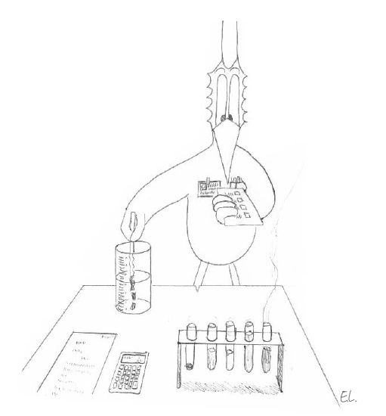
Tests
Jean-Yves Le Boudec
2021

Slide 2
Contents
The Neyman Pearson framework
Likelihood Ratio Tests
Asymptotic Results
Other Tests

Slide 3
Tests
Tests are used to give a binary answer to hypotheses of a statistical nature
Ex: is A better than B?
Ex: does this data come from a normal distribution ?

Slide 4
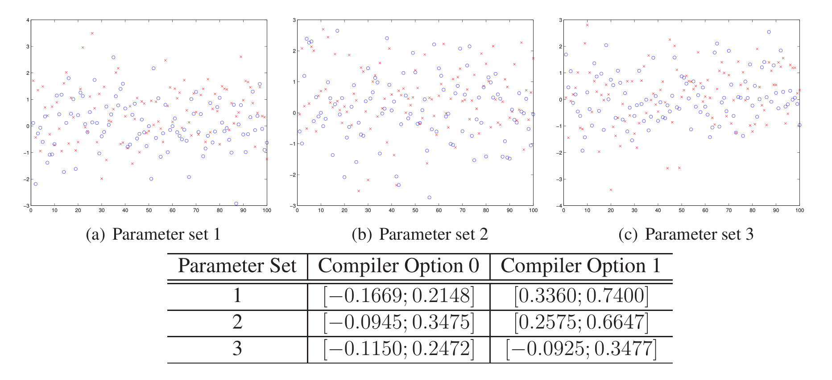
Example: Non Paired Data
Is blue (option 0) better than red (option 1) ? For Parameter Set 1 answer is clear (by inspection of confidence interval) no test required
Log of run time

Slide 5
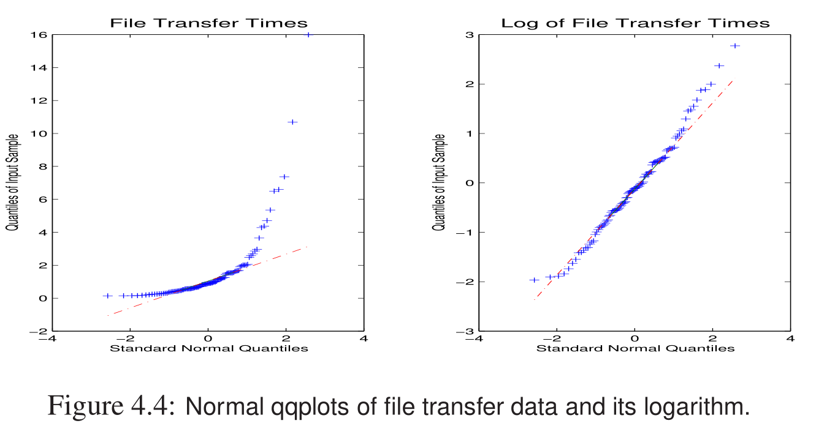
Is this data normal ?

Slide 6
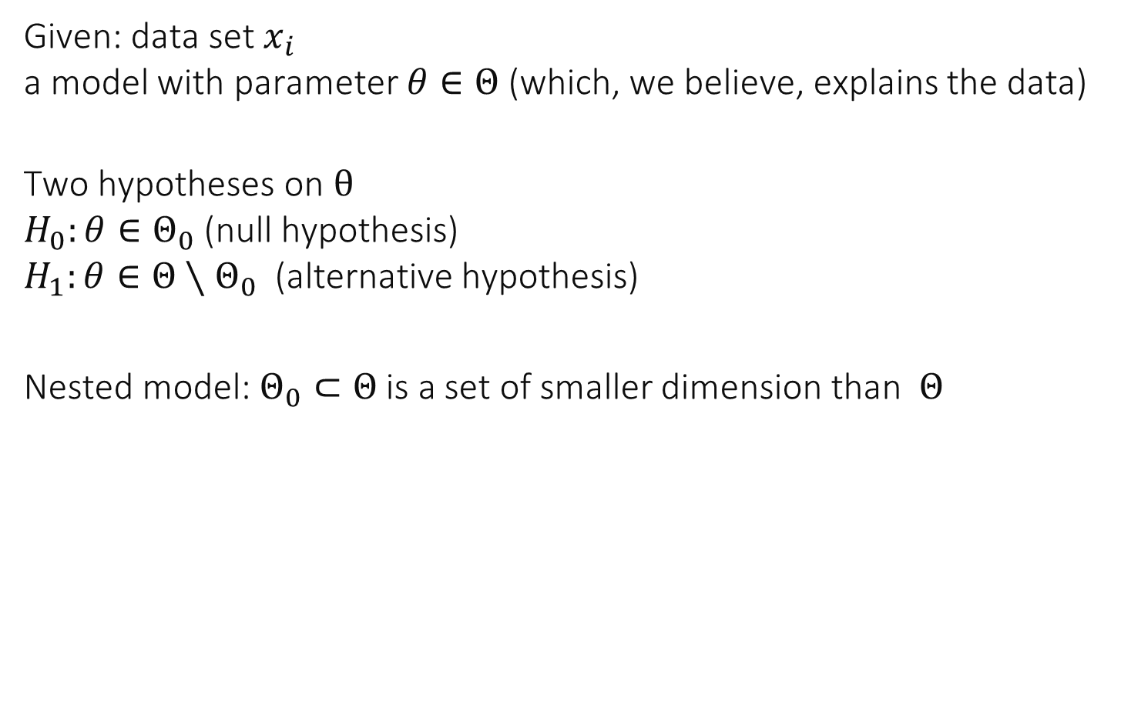
1. The Neyman-Pearson Framework
Given: data set $x_{i}$ a model with parameter $θ∈Θ$ (which, we believe, explains the data)
Two hypotheses on $θ$ $H_{0}:θ∈Θ_{0}$ (null hypothesis) $H_{1}:θ∈Θ∖Θ_{0}$ (alternative hypothesis)
Nested model: $Θ_{0}⊂Θ$ is a set of smaller dimension than $Θ$

Slide 7
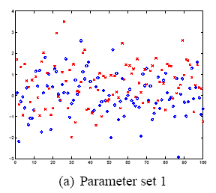
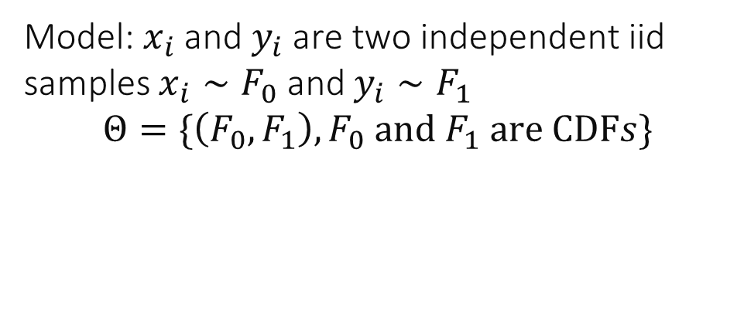
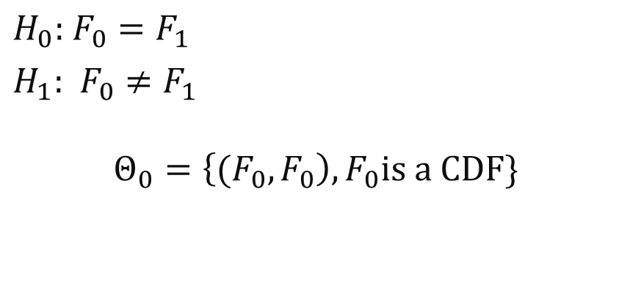
Example: Non Paired Data; Is Red better than Blue ?
$H_{0}:$ $F_{0}=F_{1}$
$H_{1}:$ $F_{0}≠F_{1}$
$$Θ_{0}=\left\{{(F}_{0},F_{0}\right), F_{0}is a CDF\}$$
Model: $x_{i}$ and $y_{i}$ are two independent iid samples $x_{i}∼F_{0}$ and $y_{i}∼F_{1}$ $$Θ=\{\left(F_{0},F_{1}\right),F_{0} and F_{1} are CDFs\}$$

Slide 8
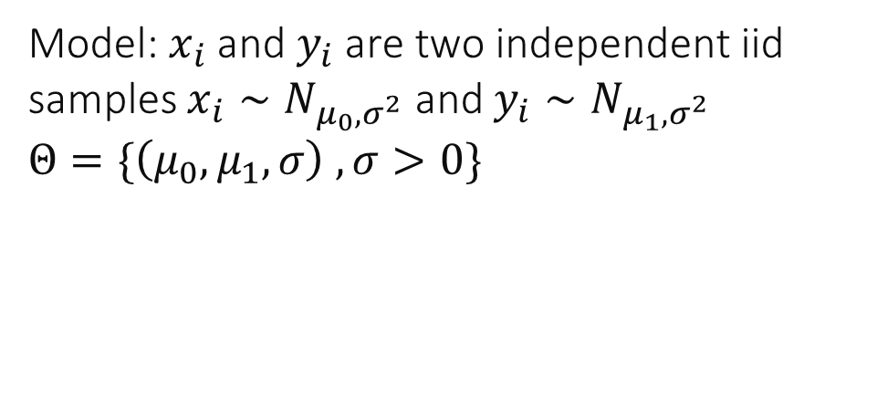
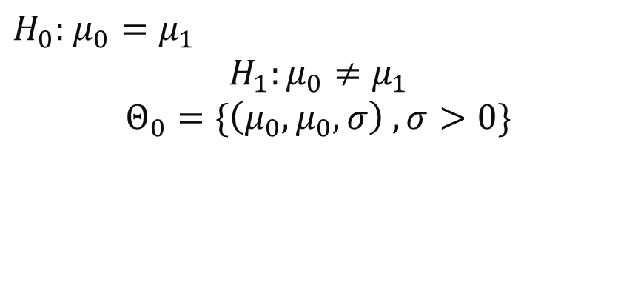
Example: Non Paired Data; Is Red better than Blue ? ANOVA Model
$H_{0}:$ $μ_{0}=μ_{1}$
$$H_{1}:μ_{0}≠μ_{1}$$
$$Θ_{0}=\{\left(μ_{0},μ_{0},σ\right) ,σ>0\}$$
Model: $x_{i}$ and $y_{i}$ are two independent iid samples $x_{i}∼N_{μ_{0},σ^{2}}$ and $y_{i}∼N_{μ_{1},σ^{2}}$ $Θ=\{\left(μ_{0},μ_{1},σ\right) ,σ>0\}$

Slide 9
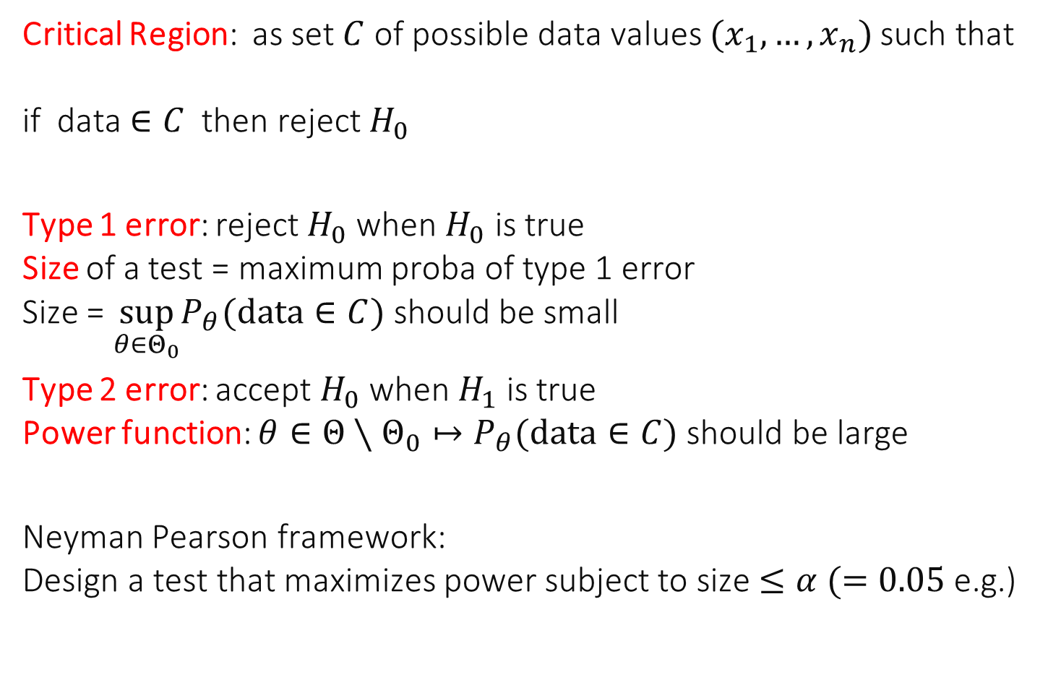
A Test is defined by its Critical Region and has a Size and Power
Critical Region: as set $C$ of possible data values $(x_{1},…,x_{n})$ such that if data $∈C$ then reject $H_{0}$
Type 1 error: reject $H_{0}$ when $H_{0}$ is true Size of a test = maximum proba of type 1 error Size = $\sup_{θ∈Θ_{0}}P_{θ}(data∈C)$ should be small
Type 2 error: accept $H_{0}$ when $H_{1}$ is true Power function: $θ∈Θ∖Θ_{0}↦P_{θ}(data∈C)$ should be large
Neyman Pearson framework: Design a test that maximizes power subject to size $≤α (=0.05$ e.g.)

Slide 10
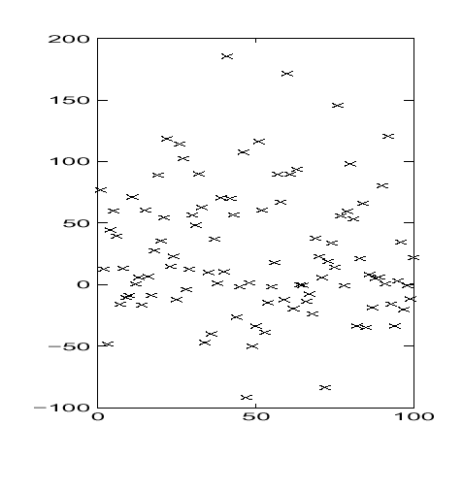
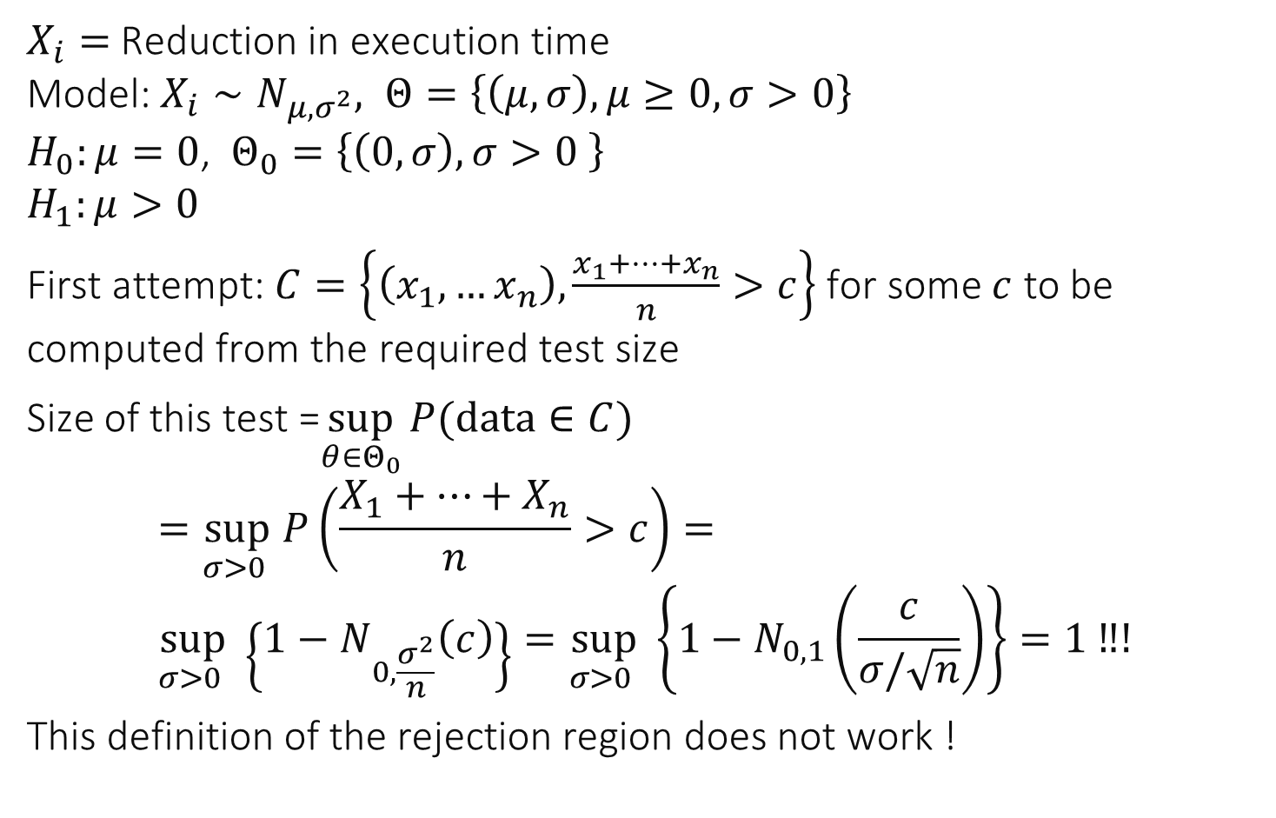
Example : Paired Data -- Is A better than B ?
$X_{i}=$Reduction in execution time Model: $X_{i}∼N_{μ,σ^{2}}, Θ=\left\{\left(μ, σ\right), μ≥0, σ>0\right\}$ $H_{0}:μ=0$, $Θ_{0}=\left\{\left(0, σ\right), σ>0 \right\}$ $H_{1}:μ>0$
First attempt: $C=\left\{\left(x_{1},…x_{n}\right), \frac{x_{1}+…+x_{n}}{n}>c\right\}$ for some $c$ to be computed from the required test size
Size of this test =$\sup_{θ∈Θ_{0}}{P(data∈C) }$ $$=\sup_{σ>0 } P\left(\frac{X_{1}+…+X_{n}}{n}>c\right)= \\ \sup_{σ>0 } \left\{1−N_{0,\frac{σ^{2}}{n}}\left(c\right)\right\}=\sup_{σ>0 } \left\{1−N_{0,1}\left(\frac{c}{σ/\sqrt{n}}\right)\right\}=1 ‼!$$
This definition of the rejection region does not work !

Slide 11
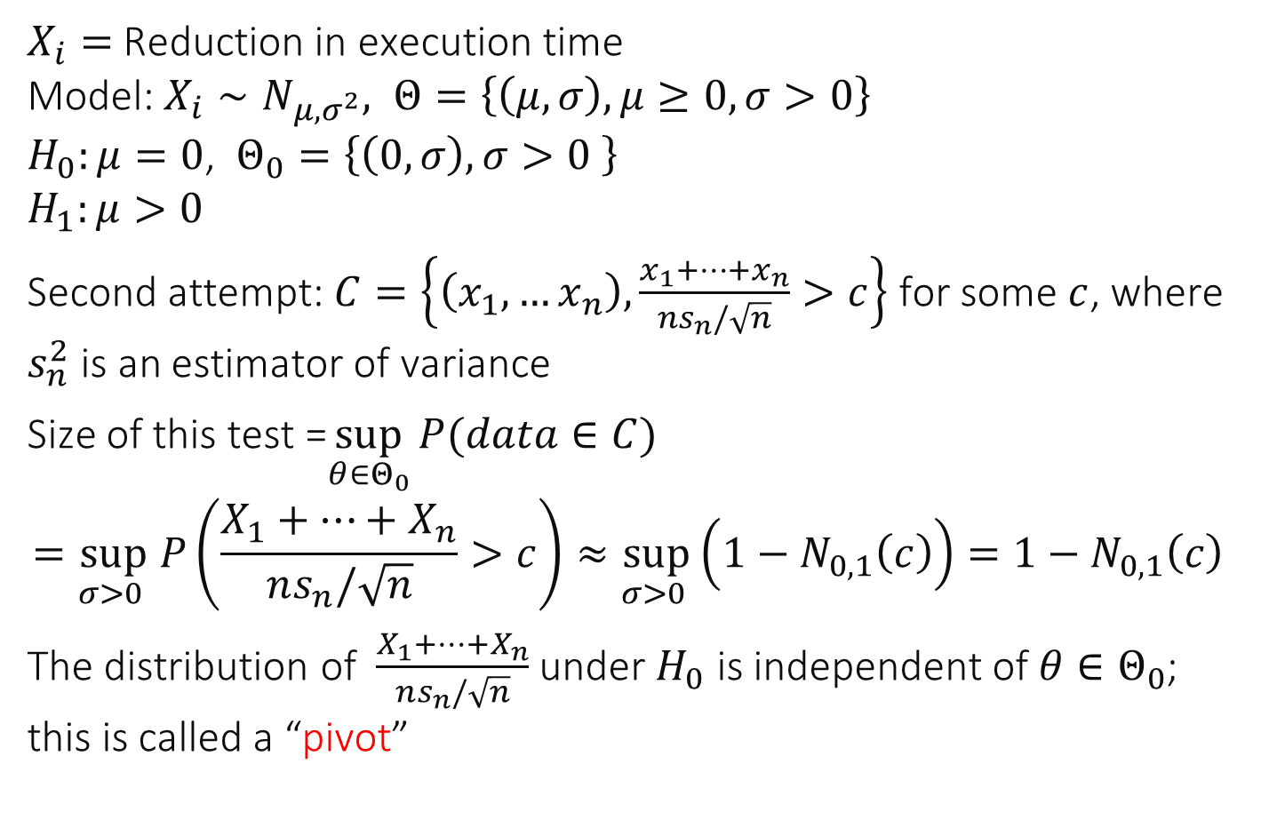
Example : Paired Data -- Is A better than B ?
$X_{i}=$Reduction in execution time Model: $X_{i}∼N_{μ,σ^{2}}, Θ=\left\{\left(μ, σ\right), μ≥0, σ>0\right\}$ $H_{0}:μ=0$, $Θ_{0}=\left\{\left(0, σ\right), σ>0 \right\}$ $H_{1}:μ>0$
Second attempt: $C=\left\{\left(x_{1},…x_{n}\right), \frac{x_{1}+…+x_{n}}{ns_{n}/\sqrt{n}}>c\right\}$ for some $c$, where $s_{n}^{2}$ is an estimator of variance
Size of this test =$\sup_{θ∈Θ_{0}}{P(data∈C) }$ $$=\sup_{σ>0 } P\left(\frac{X_{1}+…+X_{n}}{ns_{n}/\sqrt{n}}>c\right)≈\sup_{σ>0 }\left(1−N_{0, 1}\left(c\right)\right)=1−N_{0, 1}\left(c\right)$$
The distribution of $\frac{X_{1}+…+X_{n}}{ns_{n}/\sqrt{n}}$ under $H_{0}$ is independent of $θ∈Θ_{0}$; this is called a “pivot”

Slide 12
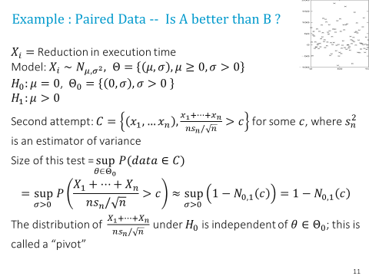

What value of $c$ should we choose for a test of size 5% ?
1.2816
1.6449
1.9600
2.32632
None of the above
I don’t know

Slide 13
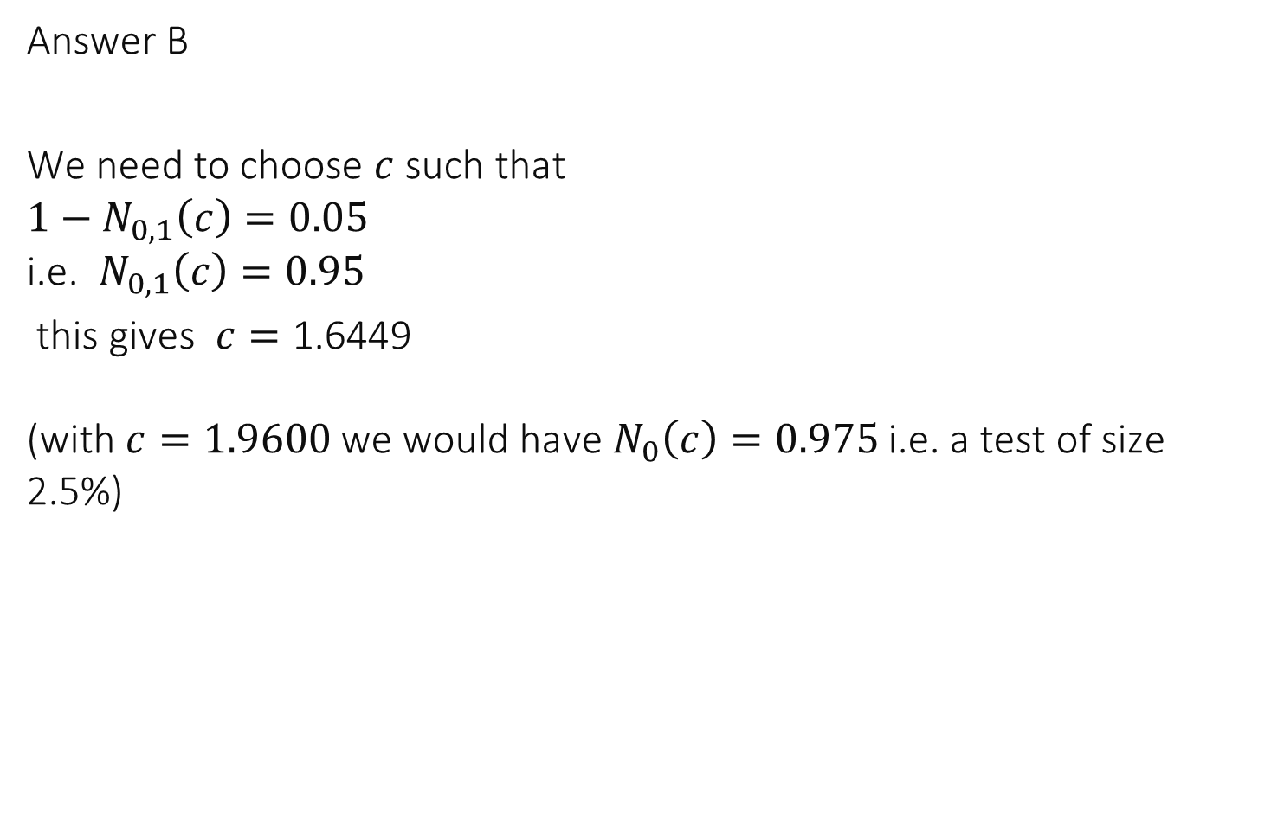
Solution
Answer B
We need to choose $c$ such that $1−N_{0,1}\left(c\right)=0.05$ i.e. $N_{0,1}\left(c\right)=0.95$
this gives $c=\text{1.6449}$ (with $c=1.9600$we would have $N_{0}\left(c\right)=0.975$ i.e. a test of size 2.5%)

Slide 14
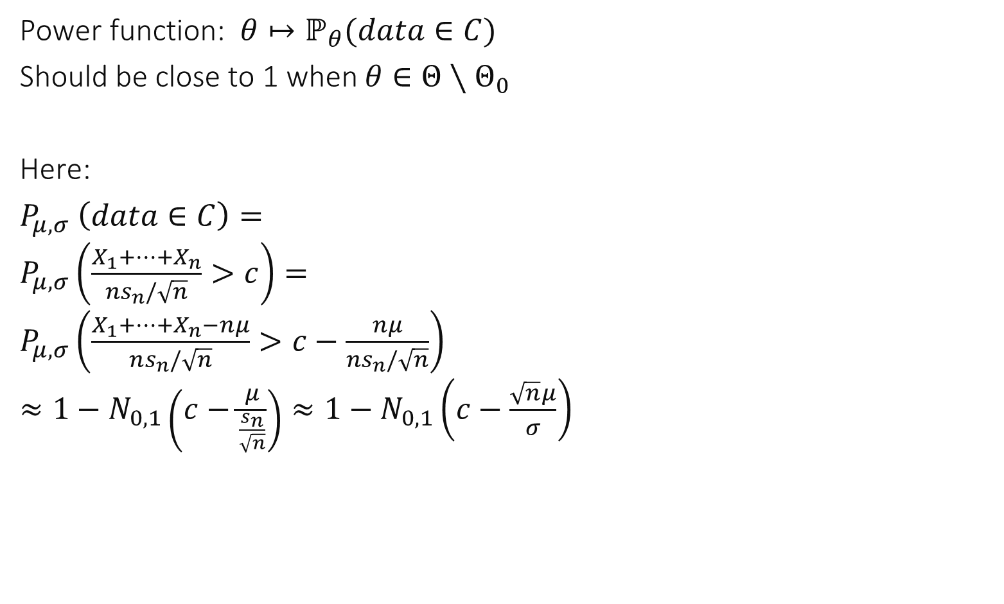
Power function
Power function: $θ↦ℙ_{θ}(data∈C)$
Should be close to 1 when $θ∈Θ∖Θ_{0}$
Here:
$P_{μ,σ} \left(data∈C\right)=$ $P_{μ, σ}\left(\frac{X_{1}+…+X_{n}}{ns_{n}/\sqrt{n}}>c\right)=$ $P_{μ, σ}\left(\frac{X_{1}+…+X_{n}−nμ}{ns_{n}/\sqrt{n}}>c−\frac{nμ}{ns_{n}/\sqrt{n}}\right)$ $≈1−N_{0,1}\left(c−\frac{μ}{\frac{s_{n}}{\sqrt{n}}}\right)≈1−N_{0,1}\left(c−\frac{\sqrt{n}μ}{σ}\right)$

Slide 15
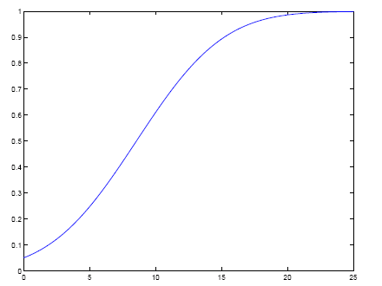
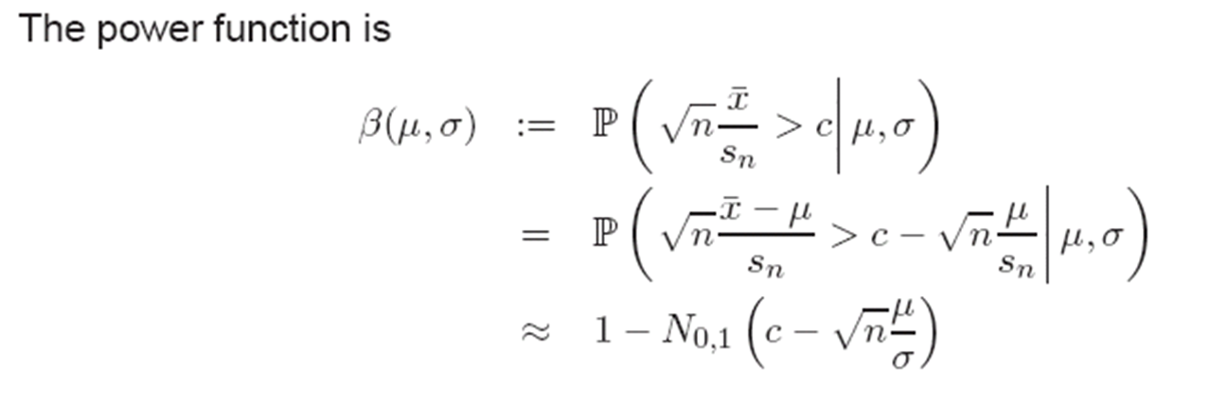
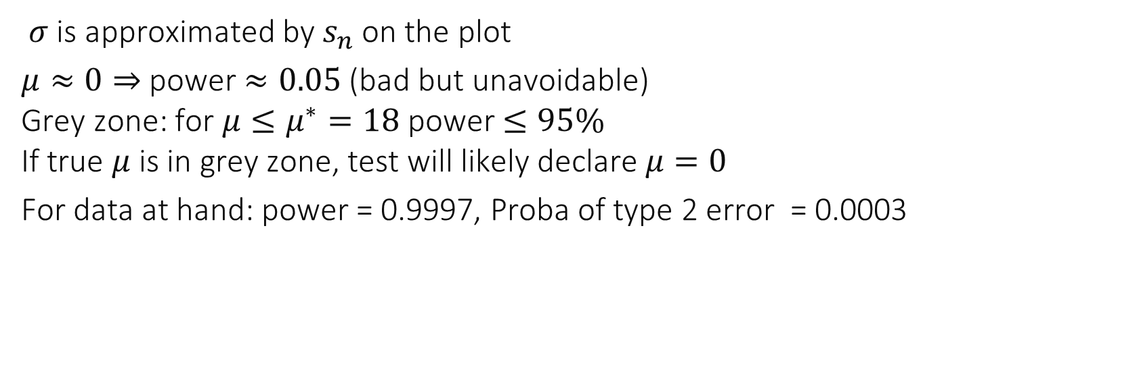
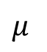
power
Grey Zone
$$μ$$
$σ$ is approximated by $s_{n}$ on the plot
$μ≈0⇒$power $≈0.05$ (bad but unavoidable) Grey zone: for $μ≤μ^{∗}=18$ power $≤95\%$ If true $μ$ is in grey zone, test will likely declare $μ=0$
For data at hand: power = 0.9997, Proba of type 2 error = 0.0003

Slide 16
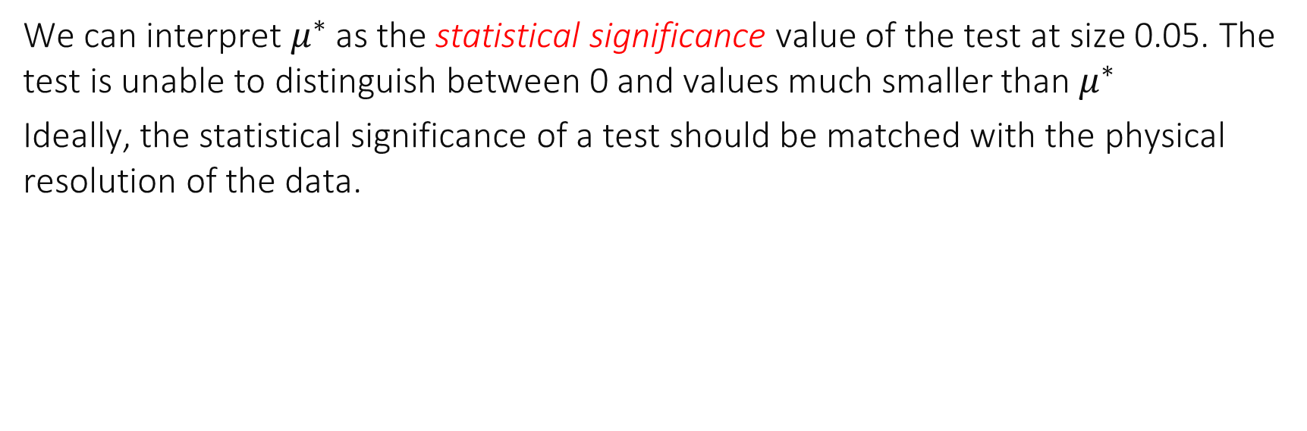
power
Grey Zone
$$μ$$
We can interpret $μ^{∗}$ as the statistical significance value of the test at size 0.05. The test is unable to distinguish between 0 and values much smaller than $μ^{∗}$
Ideally, the statistical significance of a test should be matched with the physical resolution of the data.

Slide 17
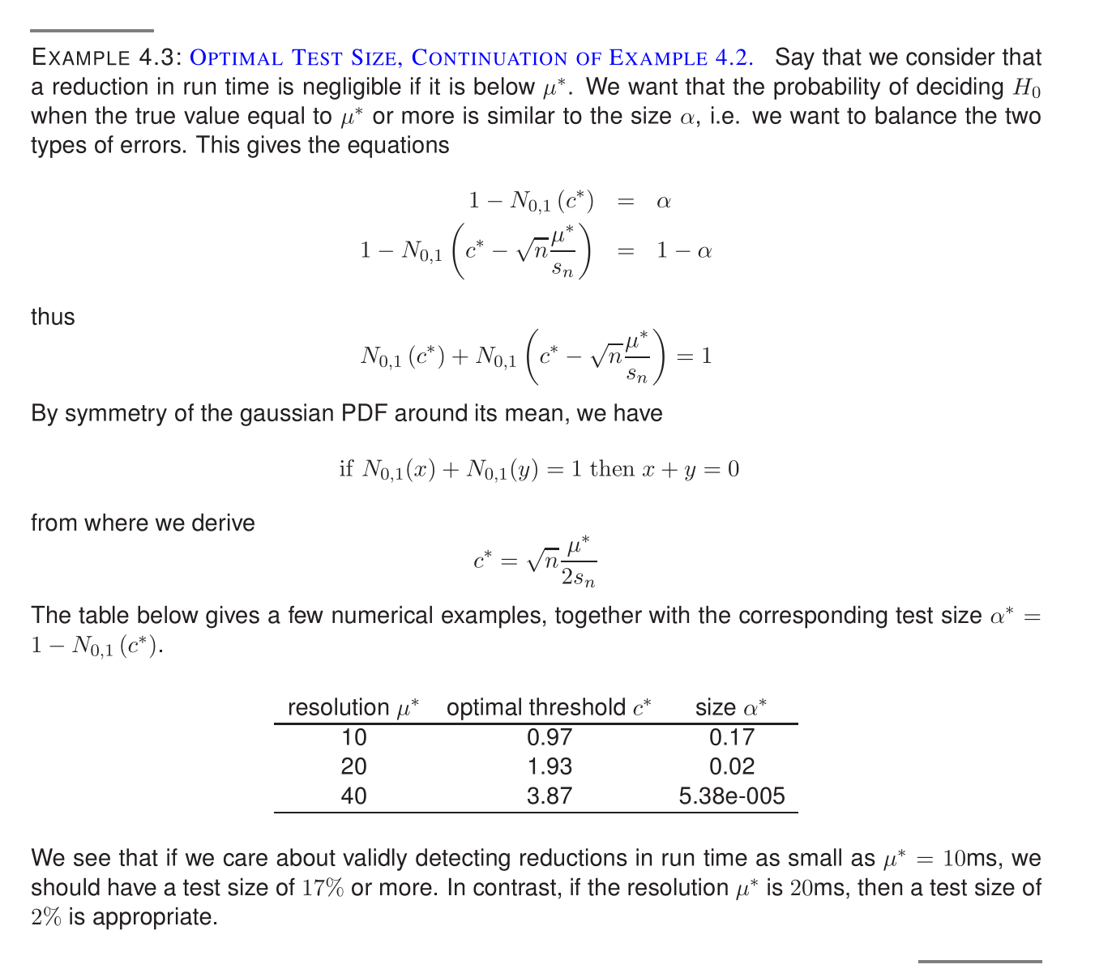

Slide 18
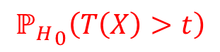
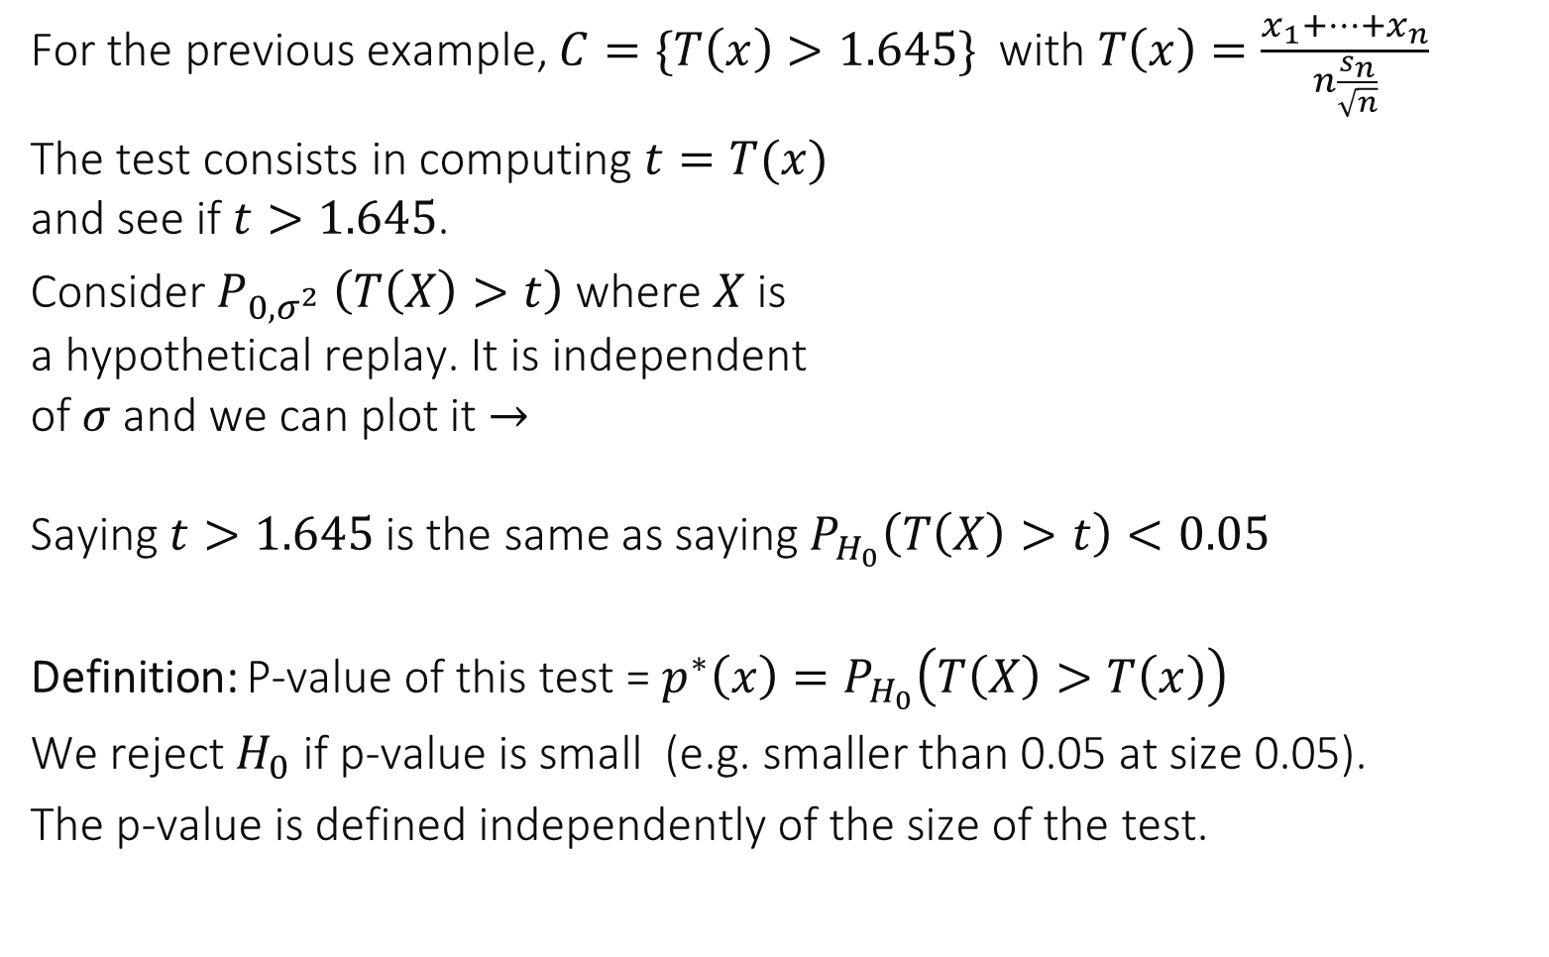

p-value of a Test
For the previous example, $C=\{T\left(x\right)>1.645\}$ with $T\left(x\right)=\frac{x_{1}+…+x_{n}}{n\frac{s_{n}}{\sqrt{n}}}$
The test consists in computing $t=T(x)$ and see if $t>1.645$.
Consider $P_{0,σ^{2}} \left(T\left(X\right)>t\right)$ where $X$is a hypothetical replay. It is independent of $σ$ and we can plot it $→$ Saying $t>1.645$ is the same as saying $P_{H_{0}}\left(T\left(X\right)>t\right)<0.05$
Definition: P-value of this test = $p^{∗}\left(x\right)=P_{H_{0}}\left(T\left(X\right)>T\left(x\right)\right)$
We reject $H_{0}$ if p-value is small (e.g. smaller than 0.05 at size 0.05).
The p-value is defined independently of the size of the test.
$${ℙ_{H}}_{0}\left(T\left(X\right)>t\right)$$
0.05
1.645
$$t$$

Slide 19
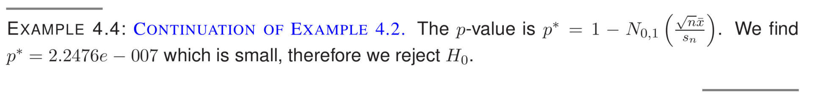
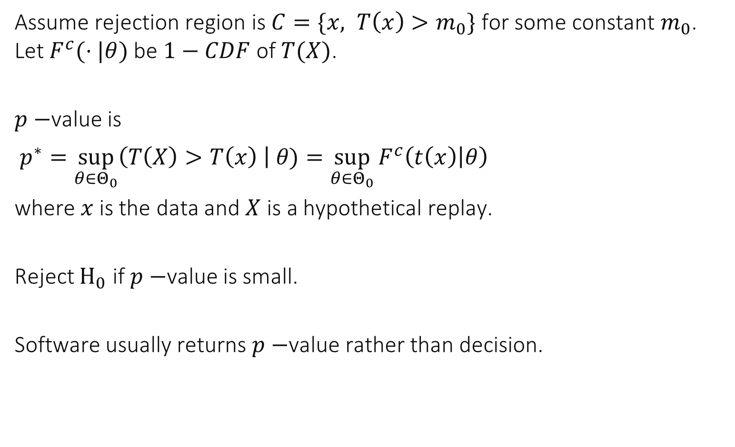
Assume rejection region is $C=\{x, T\left(x\right)>m_{0}\}$ for some constant $m_{0}$. Let $F^{c}(⋅|θ)$ be $1−CDF$ of $T(X)$.
$p−$value is
$p^{∗}=\sup_{θ∈Θ_{0}}\left(T\left(X\right)>T\left(x\right) \right| θ)=\sup_{θ∈Θ_{0}}{F^{c}\left(t\left(x\right) | θ\right)}$
where $x$ is the data and $X$ is a hypothetical replay.
Reject $H_{0}$ if $p−$value is small.
Software usually returns $p−$value rather than decision.

Slide 20
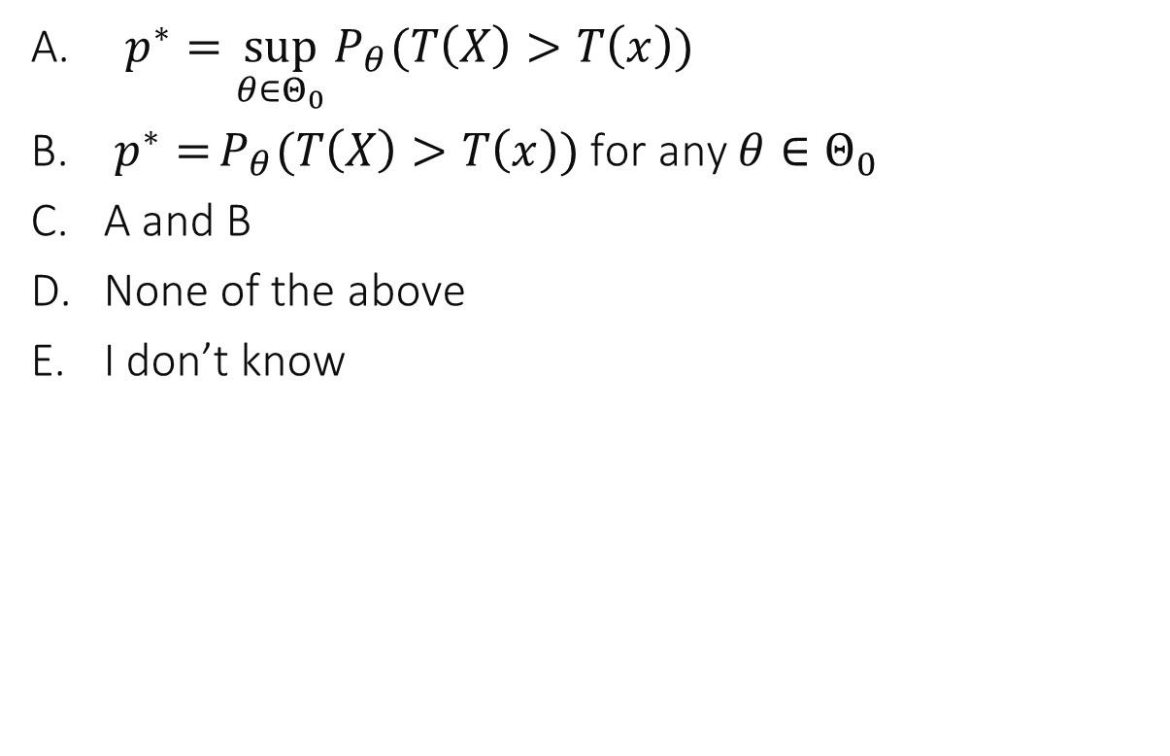

The critical region of a test has the form $\{T\left(x\right)>c\}$ where $T()$ is a pivot. $x$ is the data. $X$ is a random vector having the same distribution as the data. The p-value is given by…
$p^{∗}=\sup_{θ∈Θ_{0}}{P_{θ}(T\left(X\right)>T\left(x\right))}$
$p^{∗}={P_{θ}(T\left(X\right)>T\left(x\right))}$ for any $θ∈Θ_{0}$
A and B
None of the above
I don’t know

Slide 21
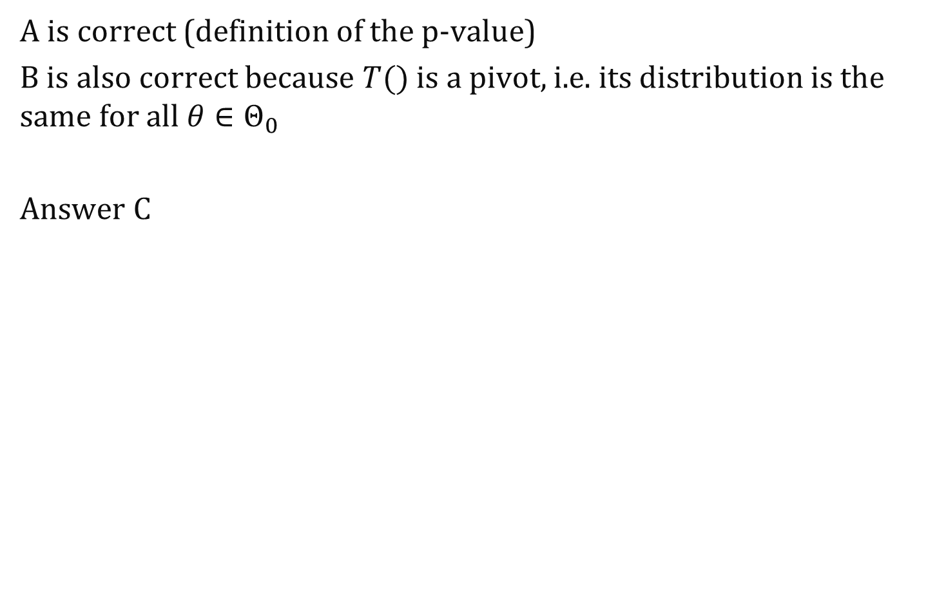
Solution
A is correct (definition of the p-value)
B is also correct because $T()$ is a pivot, i.e. its distribution is the same for all $θ∈Θ_{0}$
Answer C

Slide 22
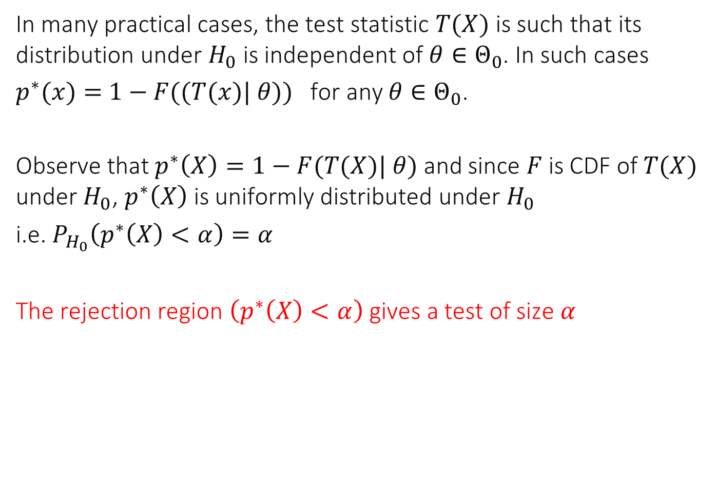
In many practical cases, the test statistic $T(X)$ is such that its distribution under $H_{0}$ is independent of $θ∈Θ_{0}$. In such cases
$p^{∗}(x)=$ $1−F((T(x)| θ))$ for any $θ∈Θ_{0}$.
Observe that $p^{∗}\left(X\right)=1−F(T(X)| θ)$ and since $F$ is CDF of $T(X)$ under $H_{0}$, $p^{∗}\left(X\right)$ is uniformly distributed under $H_{0}$
i.e. $P_{H_{0}}\left(p^{∗}\left(X\right)<α\right)=α$
The rejection region $\left(p^{∗}\left(X\right)<α\right)$ gives a test of size $α$

Slide 23
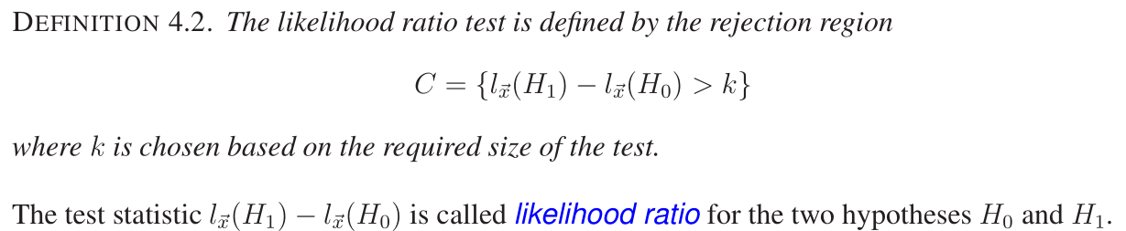
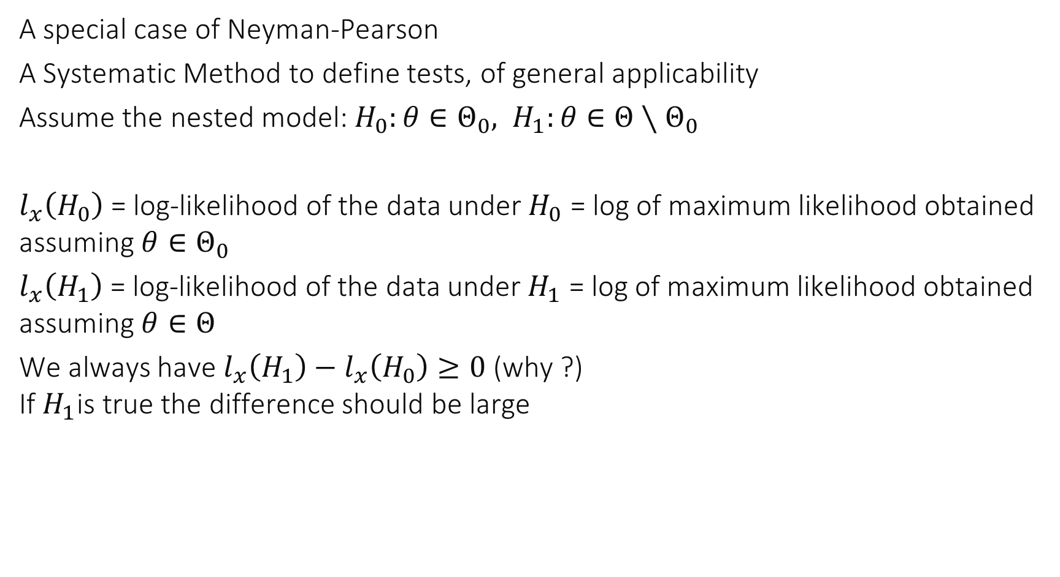
2. Likelihood Ratio Test
A special case of Neyman-Pearson
A Systematic Method to define tests, of general applicability
Assume the nested model: $H_{0}:θ∈Θ_{0}, H_{1}:θ∈Θ∖Θ_{0}$
$l_{x}\left(H_{0}\right)$ = log-likelihood of the data under $H_{0}$ = log of maximum likelihood obtained assuming $θ∈Θ_{0}$
$l_{x}\left(H_{1}\right)$ = log-likelihood of the data under $H_{1}$ = log of maximum likelihood obtained assuming $θ∈Θ$
We always have $l_{x}\left(H_{1}\right)−l_{x}\left(H_{0}\right)≥0$ (why ?) If $H_{1}$is true the difference should be large

Slide 24
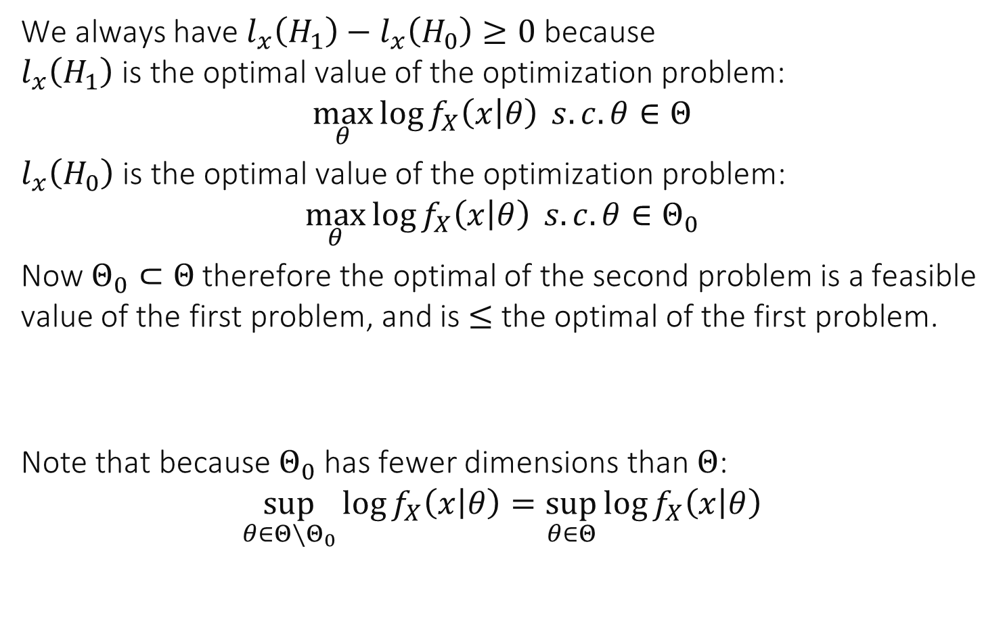
Solution
We always have $l_{x}\left(H_{1}\right)−l_{x}\left(H_{0}\right)≥0$ because $l_{x}\left(H_{1}\right)$ is the optimal value of the optimization problem:
$$\max_{θ}{\log{f_{X}\left(x | θ\right)}} s.c. θ∈Θ$$
$l_{x}\left(H_{0}\right)$ is the optimal value of the optimization problem:
$$\max_{θ}{\log{f_{X}\left(x | θ\right)}} s.c. θ∈Θ_{0}$$
Now $Θ_{0}⊂Θ$ therefore the optimal of the second problem is a feasible value of the first problem, and is $≤$ the optimal of the first problem.
Note that because $Θ_{0}$ has fewer dimensions than $Θ$:
$$\sup_{θ∈Θ∖Θ_{0}}{\log{f_{X}\left(x | θ\right)}}=\sup_{θ∈Θ}{\log{f_{X}\left(x | θ\right)}}$$

Slide 25
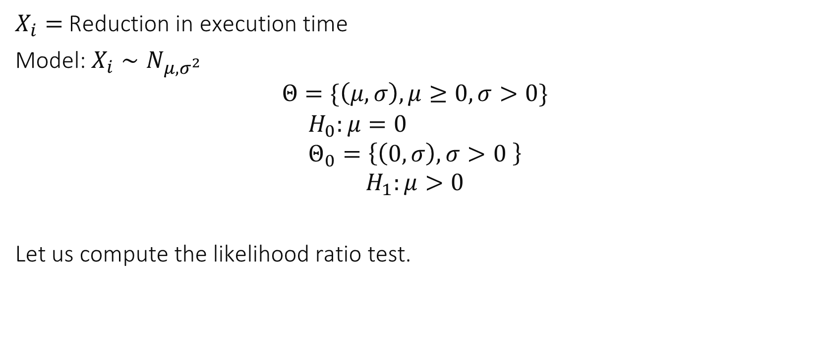
Example : Paired Data Is A better than B ?
$X_{i}=$Reduction in execution time
Model: $X_{i}∼N_{μ,σ^{2}}$ $$Θ=\{\left(μ, σ\right), μ≥0, σ>0\}$$
$$H_{0}:μ=0 \\ Θ_{0}=\left\{\left(0, σ\right), σ>0 \right\}$$
$$H_{1}:μ>0$$
Let us compute the likelihood ratio test.

Slide 26
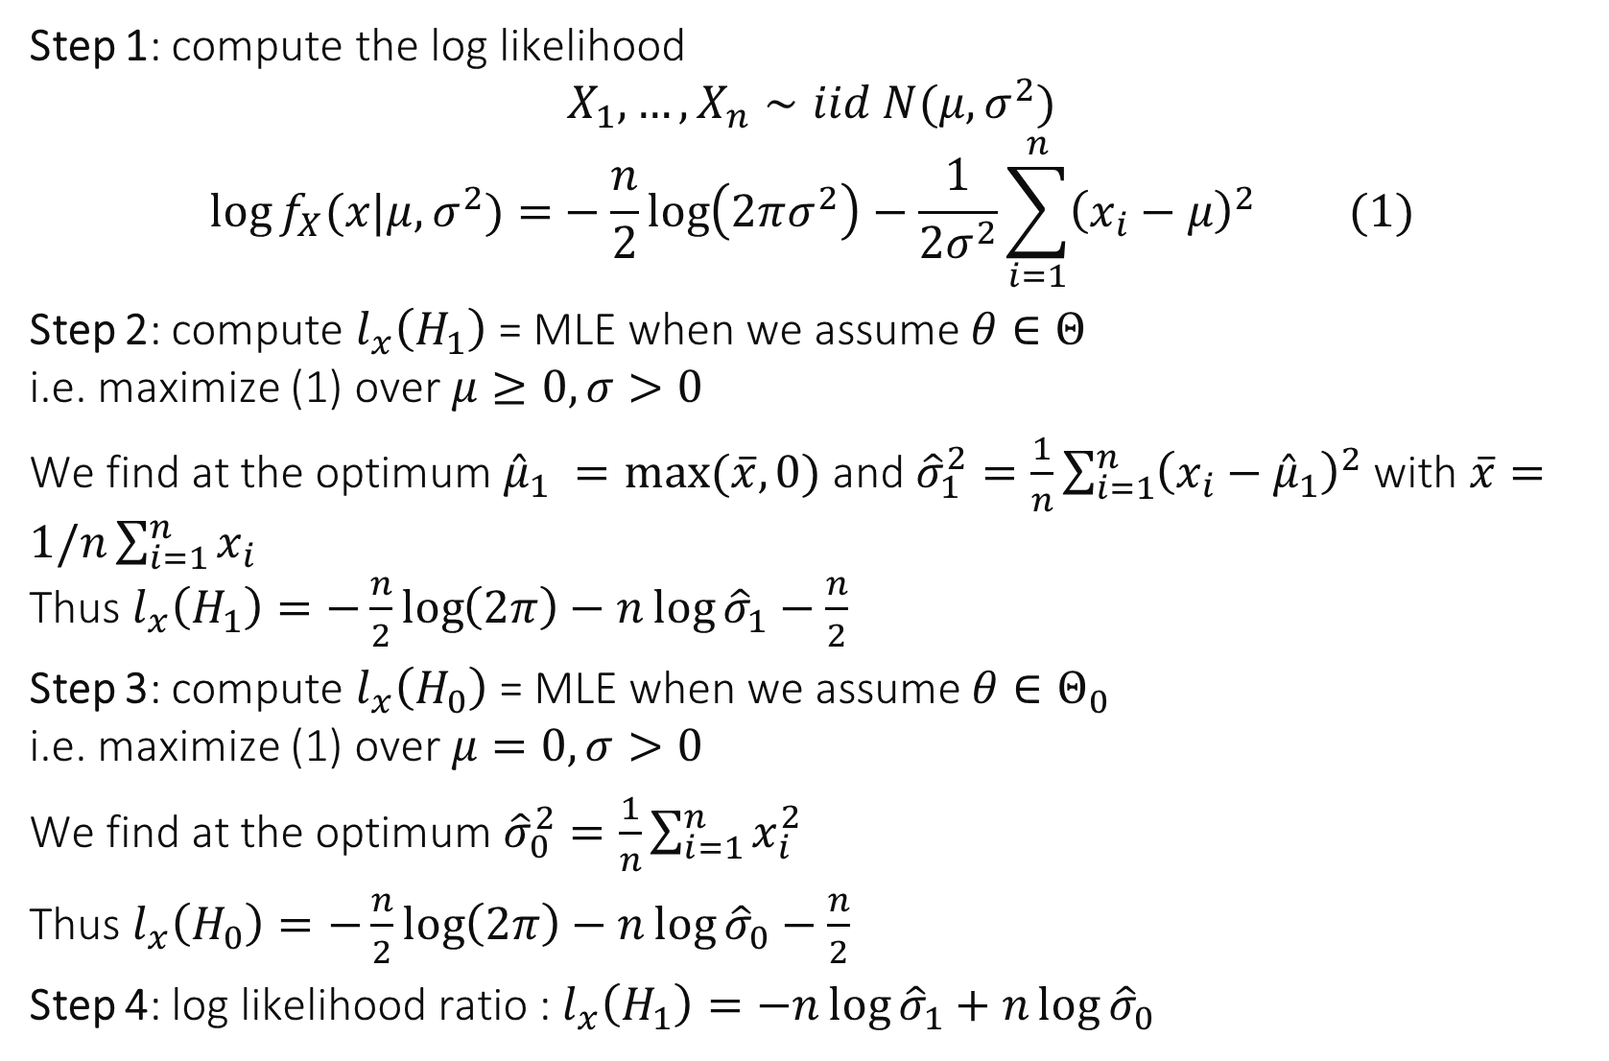
Step 1: compute the log likelihood $$X_{1}, …, X_{n}∼iid N(μ,σ^{2})$$
$$\log{f_{X}(x|μ,σ^{2})=}−\frac{n}{2}\log\left(2πσ^{2}\right)−\frac{1}{2σ^{2}}\sum_{i=1}^{n}{{\left(x_{i}−μ\right)}^{2}} (1)$$
Step 2: compute $l_{x}\left(H_{1}\right)$ = MLE when we assume $θ∈Θ$ i.e. maximize (1) over $μ≥0, σ>0$
We find at the optimum ${\hat{μ}}_{1} =max⁡(\overline{x},0)$ and ${\hat{σ}}_{1}^{2}=\frac{1}{n}\sum_{i=1}^{n}{{\left(x_{i}−{\hat{μ}}_{1}\right)}^{2}}$ with $\overline{x}=1/n\sum_{i=1}^{n}{x_{i}}$ Thus $l_{x}\left(H_{1}\right)=−\frac{n}{2}\log\left(2π\right)−n\log{{\hat{σ}}_{1}}−\frac{n}{2}$
Step 3: compute $l_{x}\left(H_{0}\right)$ = MLE when we assume $θ∈Θ_{0}$ i.e. maximize (1) over $μ=0, σ>0$
We find at the optimum ${\hat{σ}}_{0}^{2}=\frac{1}{n}\sum_{i=1}^{n}{x_{i}^{2}}$
Thus $l_{x}\left(H_{0}\right)=−\frac{n}{2}\log\left(2π\right)−n\log{{\hat{σ}}_{0}}−\frac{n}{2}$
Step 4: log likelihood ratio : $l_{x}\left(H_{1}\right)=−n\log{{\hat{σ}}_{1}}+n\log{{\hat{σ}}_{0}}$

Slide 27
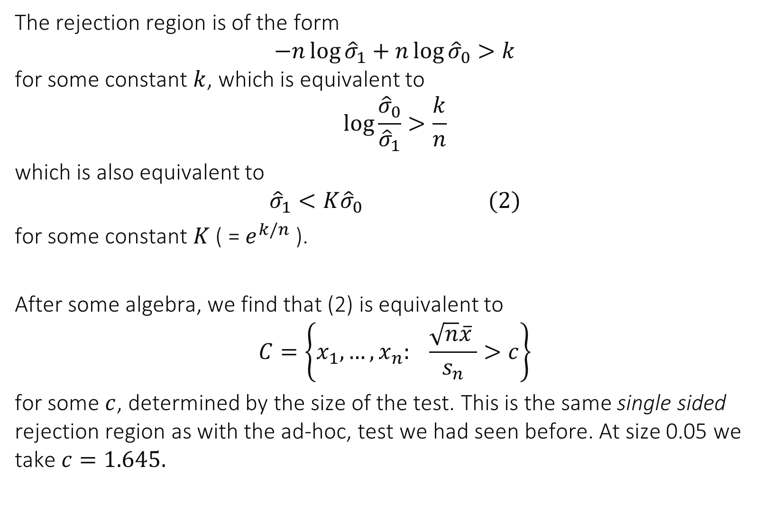
The rejection region is of the form $$−n\log{{\hat{σ}}_{1}}+n\log{{\hat{σ}}_{0}}>k$$ for some constant $k$, which is equivalent to
$$\log{\frac{{\hat{σ}}_{0}}{{\hat{σ}}_{1}}}>\frac{k}{n}$$ which is also equivalent to
$${\hat{σ}}_{1}<K{\hat{σ}}_{0} (2)$$
for some constant $K$ ( = $e^{k/n}$ ).
After some algebra, we find that (2) is equivalent to
$$C=\left\{x_{1},…,x_{n}: \frac{\sqrt{n}\overline{x} }{s_{n}}>c\right\}$$
for some $c$, determined by the size of the test. This is the same single sided rejection region as with the ad-hoc, test we had seen before. At size 0.05 we take $c=1.645.$

Slide 28
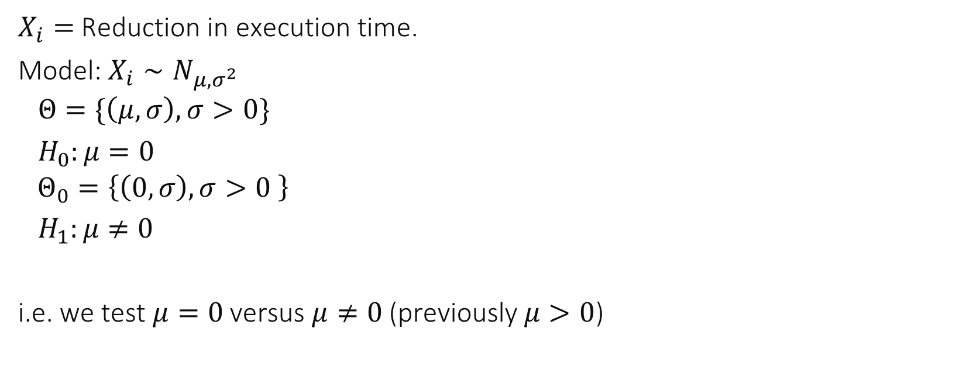
A Two-Sided Variant of the Previous Test
$X_{i}=$Reduction in execution time.
Model: $X_{i}∼N_{μ,σ^{2}}$ $Θ=\{\left(μ, σ\right), σ>0\}$
$H_{0}:μ=0$ $Θ_{0}=\left\{\left(0, σ\right), σ>0 \right\}$
$H_{1}:μ≠0$
i.e. we test $μ=0$versus $μ≠0$ (previously $μ>0$)

Slide 29
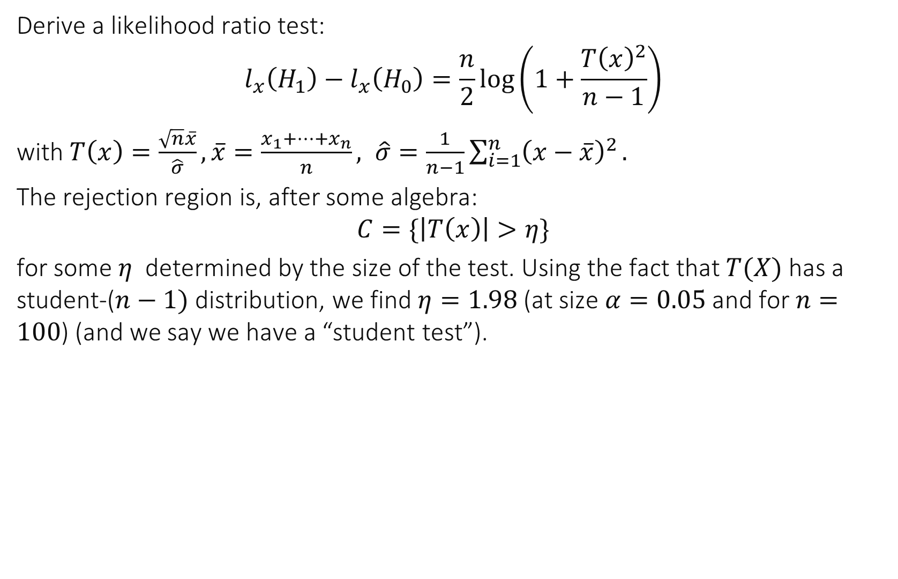
Derive a likelihood ratio test:
$$l_{x}\left(H_{1}\right)−l_{x}\left(H_{0}\right)=\frac{n}{2}\log\left(1+\frac{T{\left(x\right)}^{2}}{n−1}\right)$$
with $T\left(x\right)=\frac{\sqrt{n}\overline{x}}{\hat{σ}}, \overline{x}=\frac{x_{1}+…+x_{n}}{n}, \hat{σ}=\frac{1}{n−1}\sum_{i=1}^{n}{{\left(x−\overline{x}\right)}^{2}}.$
The rejection region is, after some algebra:
$$C=\{\left|T\left(x\right)\right|>η\}$$
for some $η$ determined by the size of the test. Using the fact that $T(X)$ has a student-($n−1)$ distribution, we find $η=1.98$(at size $α=0.05$ and for $n=100$) (and we say we have a “student test”).

Slide 30
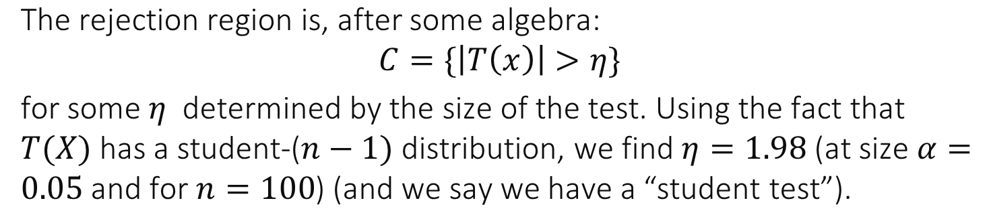
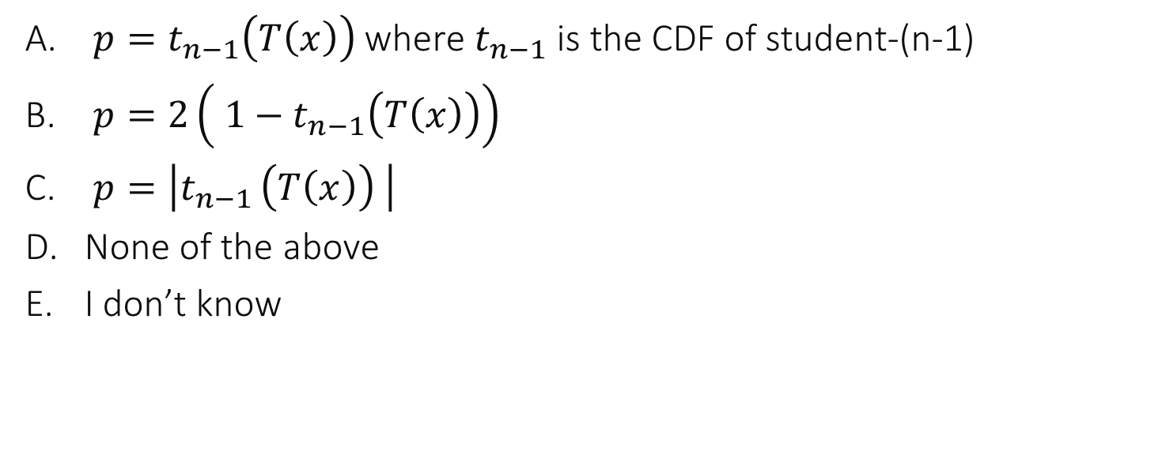
What is the p-value of this test ?
$p=t_{n−1}\left(T\left(x\right)\right)$ where $t_{n−1}$ is the CDF of student-(n-1)
$p=2\left( 1−t_{n−1}\left(T\left(x\right)\right)\right)$
$p=\left|t_{n−1 }\left(T\left(x\right)\right) \right|$
None of the above
I don’t know

Slide 31
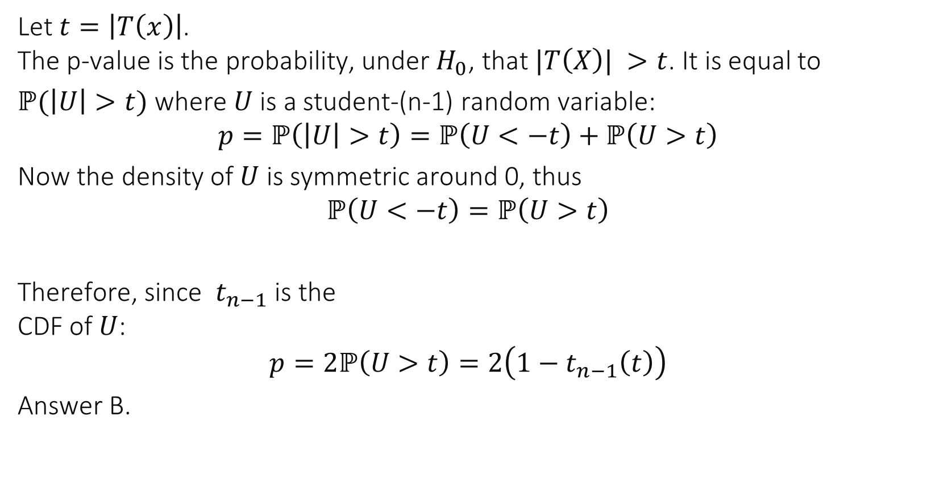
Solution
Let $t=\left|T\left(x\right)\right|$. The p-value is the probability, under $H_{0}$, that $|T\left(X\right)| >t$. It is equal to
$ℙ(\left|U\right|>t)$ where $U$ is a student-(n-1) random variable:
$$p=ℙ\left(\left|U\right|>t\right)=ℙ\left(U<−t\right)+ℙ\left(U>t\right)$$
Now the density of $U$ is symmetric around 0, thus $$ℙ\left(U<−t\right)=ℙ\left(U>t\right)$$
Therefore, since $t_{n−1}$ is the CDF of $U$:
$$p=2ℙ\left(U>t\right)=2\left(1−t_{n−1}\left(t\right)\right)$$
Answer B.

Slide 32
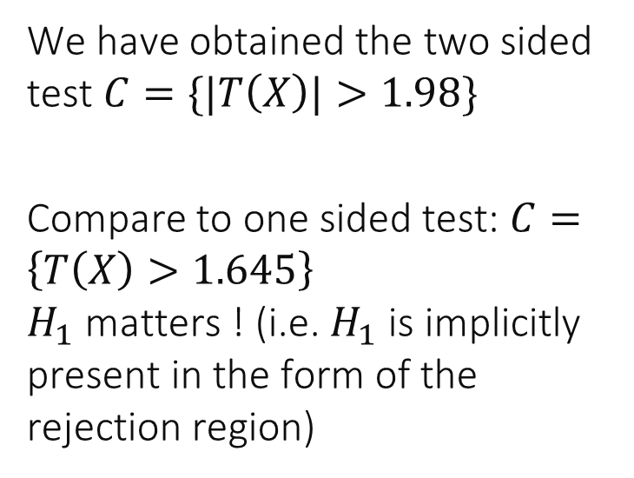
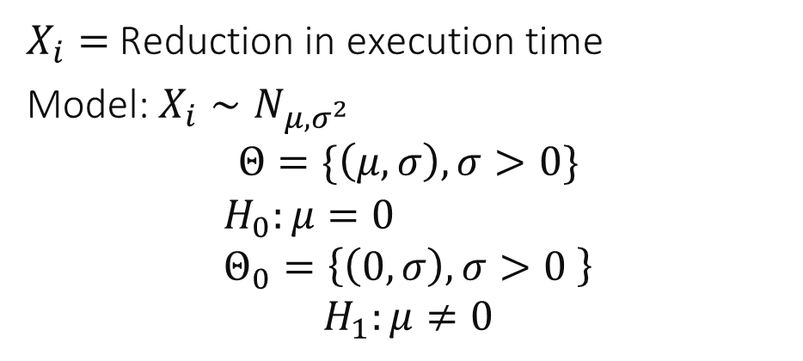
The Two-Sided Test
$X_{i}=$Reduction in execution time
Model: $X_{i}∼N_{μ,σ^{2}}$ $$Θ=\{\left(μ, σ\right), σ>0\}$$
$$H_{0}:μ=0 \\ Θ_{0}=\left\{\left(0, σ\right), σ>0 \right\}$$
$$H_{1}:μ≠0$$
We have obtained the two sided test $C=\{|T\left(X\right)|>1.98\}$
Compare to one sided test: $C=\left\{T\left(X\right)>1.645\right\}$ $H_{1}$ matters ! (i.e. $H_{1}$ is implicitly present in the form of the rejection region)

Slide 33
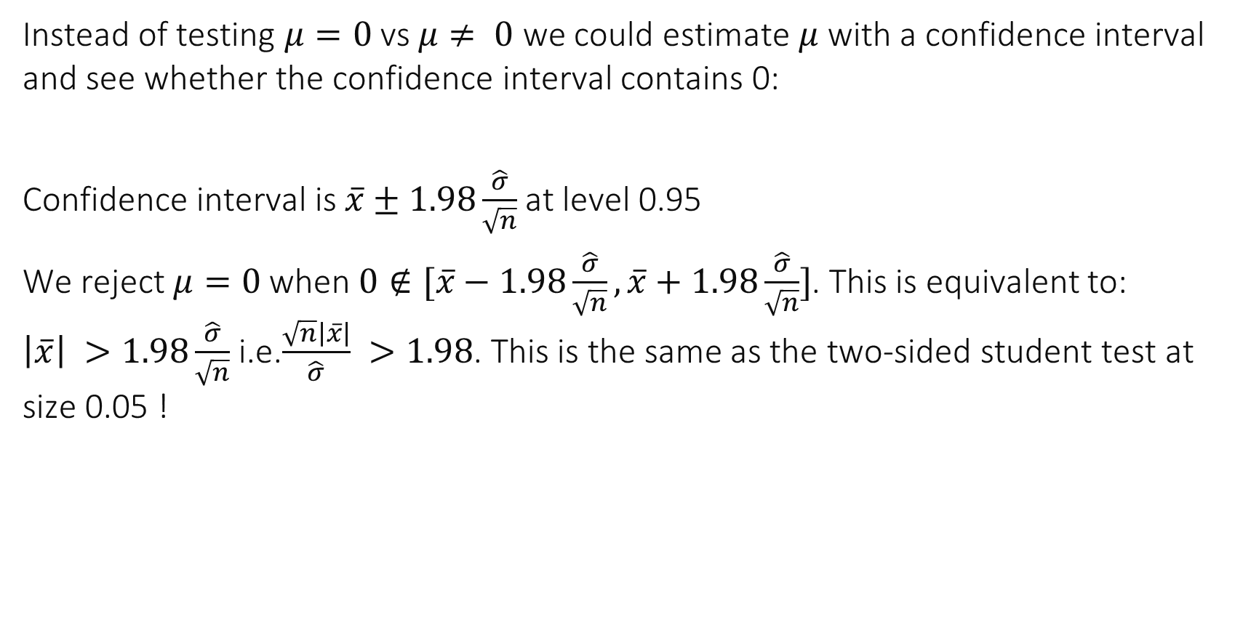
Here, the two-sided test is the same as a Conf. Interval
Instead of testing $μ=0$ vs $μ≠ 0$ we could estimate $μ$ with a confidence interval and see whether the confidence interval contains 0:
Confidence interval is $\overline{x}±1.98\frac{\hat{σ}}{\sqrt{n}}$ at level 0.95
We reject $μ=0$ when $0∉[\overline{x}−1.98\frac{\hat{σ}}{\sqrt{n}},\overline{x}+1.98\frac{\hat{σ}}{\sqrt{n}}]$. This is equivalent to: $\left|\overline{x}\right| >1.98\frac{\hat{σ}}{\sqrt{n}}$ i.e.$\frac{\sqrt{n}\left|\overline{x}\right|}{\hat{σ}} >1.98$. This is the same as the two-sided student test at size 0.05 !

Slide 34
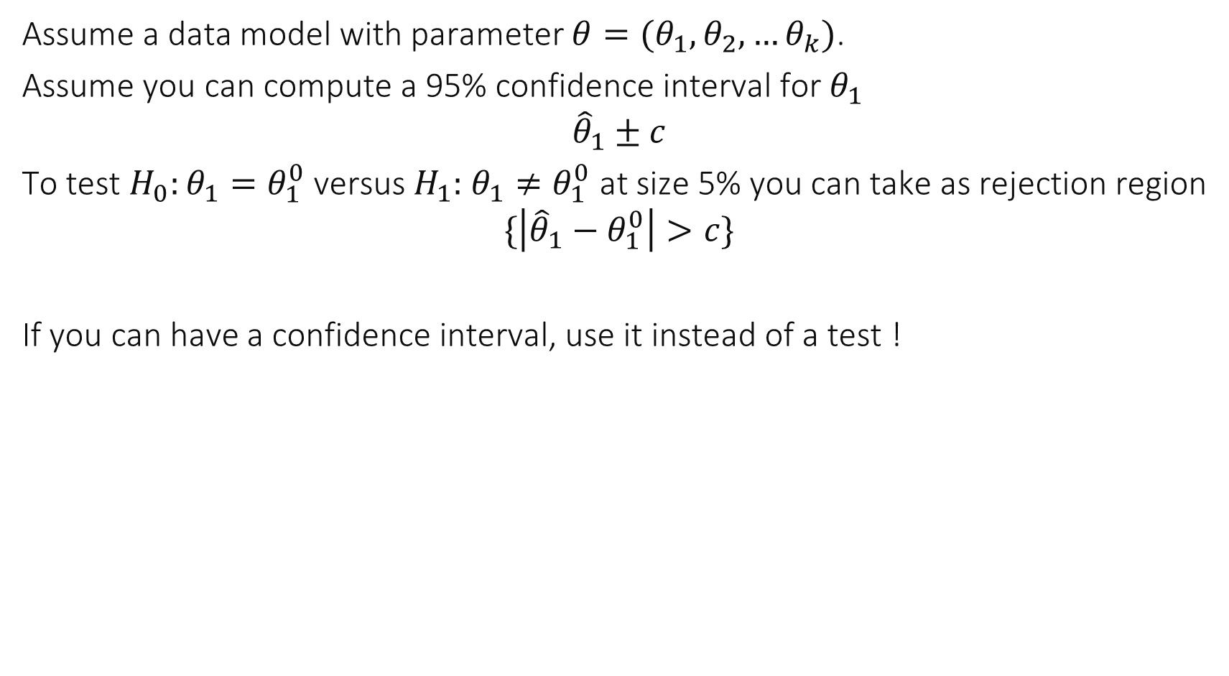
Test versus Confidence Intervals
Assume a data model with parameter $θ=(θ_{1}, θ_{2},…θ_{k})$.
Assume you can compute a 95% confidence interval for $θ_{1}$
$${\hat{θ}}_{1}±c$$
To test $H_{0}:θ_{1}=θ_{1}^{0}$ versus $H_{1}:$ $θ_{1}≠θ_{1}^{0}$ at size 5% you can take as rejection region
$$\{\left|{\hat{θ}}_{1}−θ_{1}^{0}\right|>c\}$$
If you can have a confidence interval, use it instead of a test !

Slide 35
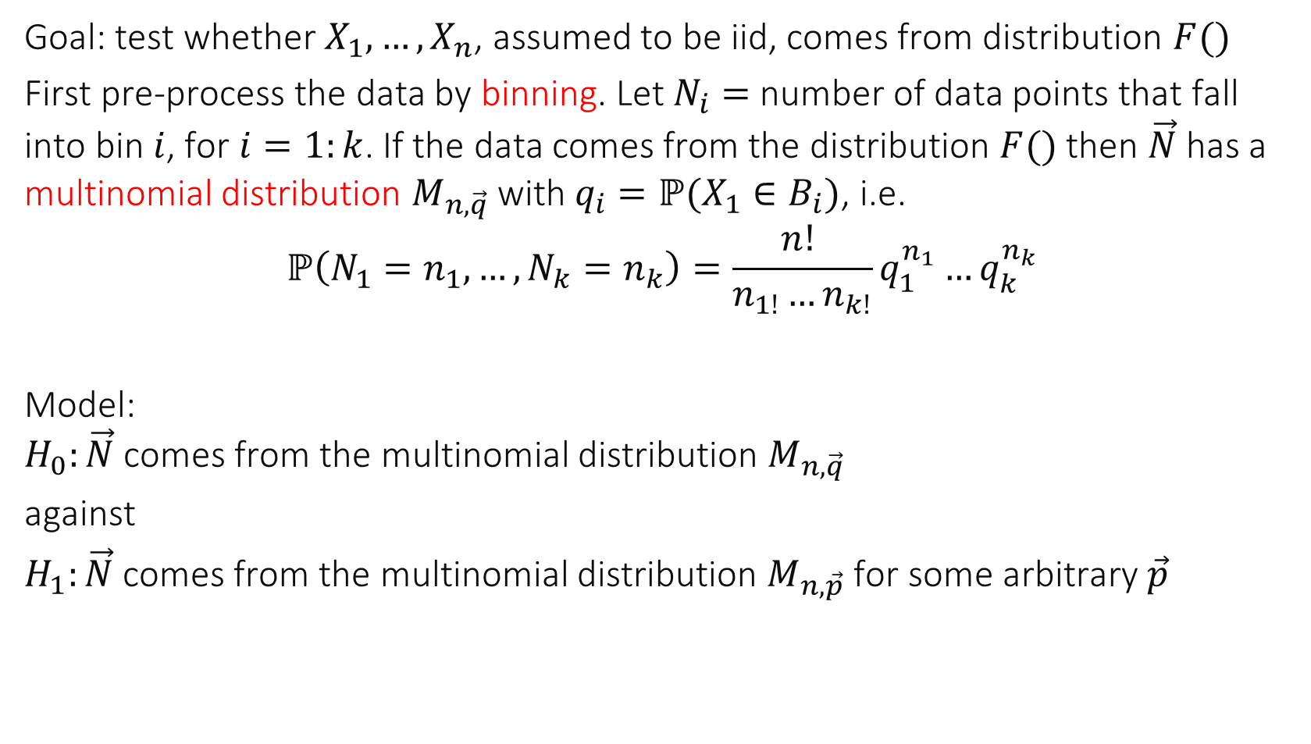
The “Simple Goodness of Fit” Test
Goal: test whether $X_{1},…,X_{n}$, assumed to be iid, comes from distribution $F()$
First pre-process the data by binning. Let $N_{i}=$ number of data points that fall into bin $i$, for $i=1:k$. If the data comes from the distribution $F()$ then $\vec{N}$ has a multinomial distribution $M_{n,\vec{q}}$ with $q_{i}=ℙ(X_{1}∈B_{i})$, i.e.
$$ℙ\left(N_{1}=n_{1},…,N_{k}=n_{k}\right)=\frac{n! }{n_{1!}…n_{k!}}q_{1}^{n_{1}}…q_{k}^{n_{k}}$$
Model: $H_{0}:\vec{N}$ comes from the multinomial distribution $M_{n, \vec{q}}$
against
$H_{1}:\vec{N}$ comes from the multinomial distribution $M_{n, \vec{p}}$ for some arbitrary $\vec{p}$

Slide 36
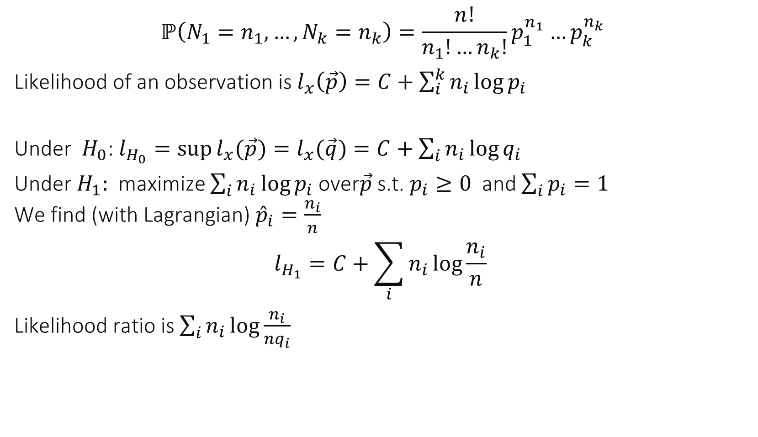
Compute likelihood ratio statistic
$$ℙ\left(N_{1}=n_{1},…,N_{k}=n_{k}\right)=\frac{n!}{n_{1}!…n_{k}!}p_{1}^{n_{1}}…p_{k}^{n_{k}}$$
Likelihood of an observation is $l_{x}\left(\vec{p}\right)=C+\sum_{i}^{k}{n_{i}\log{p_{i}}}$
Under $H_{0}$: $l_{H_{0}}=\sup{l_{x}(\vec{p})=l_{x}(\vec{q})}=C+\sum_{i}{n_{i}\log{q_{i}}}$
Under $H_{1}:$maximize $\sum_{i}{n_{i}\log{p_{i}}}$over$\vec{p}$ s.t. $p_{i}≥0$ and $\sum_{i}{p_{i}=1 }$ We find (with Lagrangian) ${\hat{p}}_{i}=\frac{n_{i}}{n}$ $$l_{H_{1}}=C+\sum_{i}{n_{i}\log{\frac{n_{i}}{n} }}$$
Likelihood ratio is $\sum_{i}{n_{i}\log{\frac{n_{i}}{nq_{i}} }}$

Slide 37
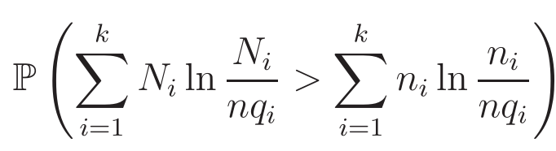
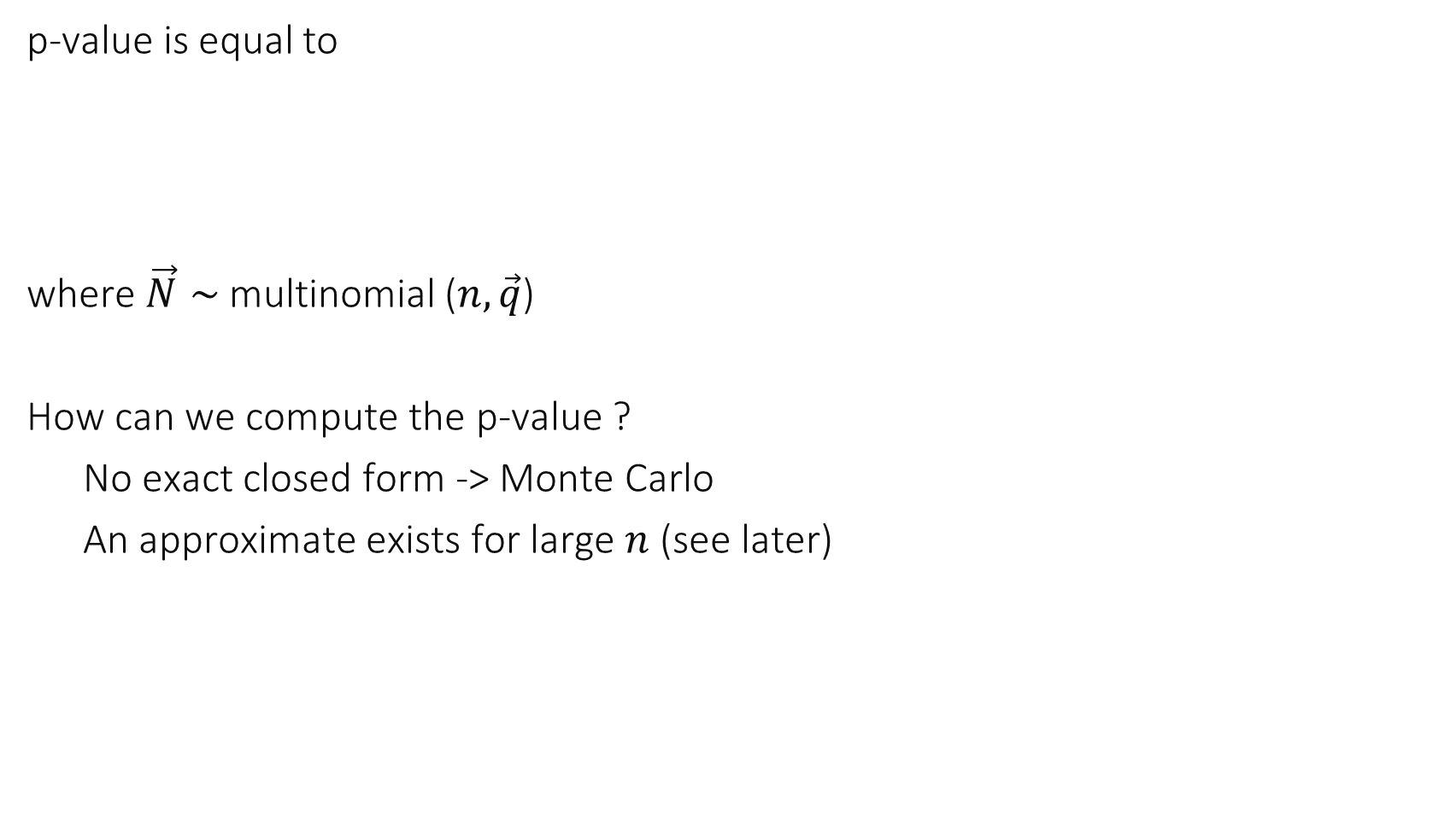
Compute p-value
p-value is equal to
where $\vec{N}∼$multinomial ($n,\vec{q}$)
How can we compute the p-value ?
No exact closed form -> Monte Carlo
An approximate exists for large $n$ (see later)

Slide 38
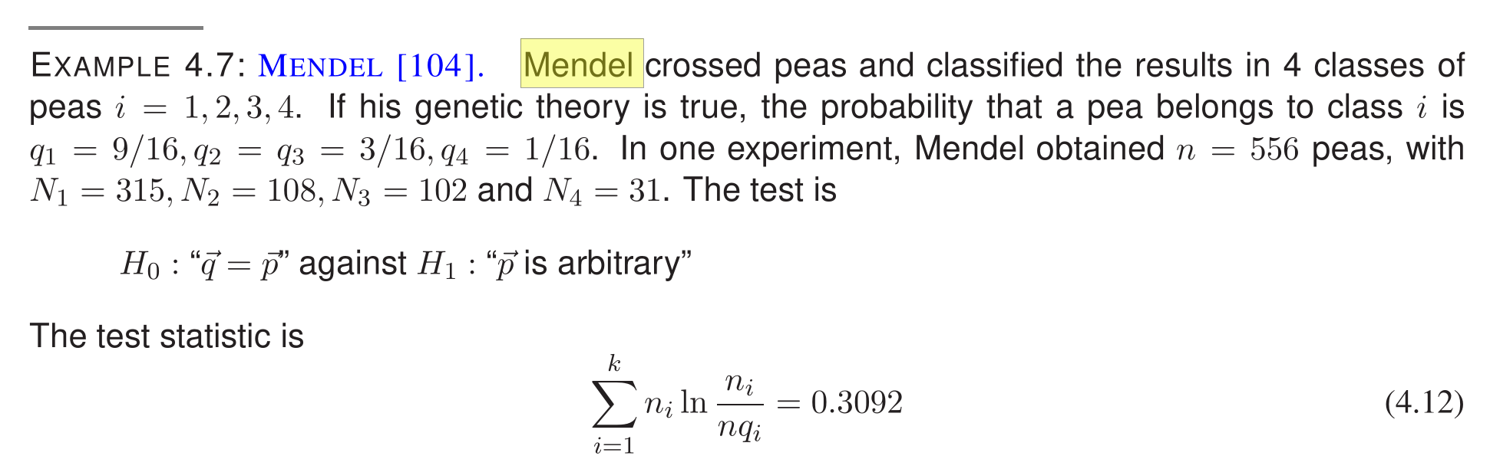
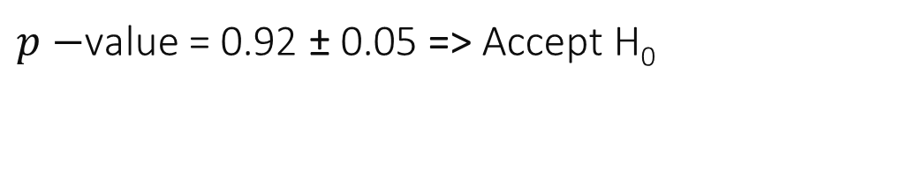
Mendel’s Peas
$p−$value = 0.92 ± 0.05 => Accept H₀

Slide 39

We design a likelihood ratio test with $H_{0}:θ=θ_{0}$, $H_{1}:θ∈Θ∖\{θ_{0}\}$. The data is $x$. The p-value is equal to …
$P_{θ_{0}}(lrs\left(X\right)>lrs(x))$ where X is a replay experiment
$P_{θ_{0}}(lrs\left(X\right)<lrs(x))$ where X is a replay experiment
$\sup_{θ∈Θ}{P_{θ_{0}}(lrs\left(X\right)>lrs(x))}$ where X is a replay experiment
None of the above
I don’t know

Slide 40

Solution
The critical region is $\left\{lrs\left(x\right)>c\right\}$ for some $c.$ Therefore the definition of a p-value applies and we obtain Answer A

Slide 41

3. Asymptotic Result
Applicable to a likelihood ratio test when central limit theorem holds, i.e. when distributions have finite variances and $n$ is large
If applicable, radically simple
Compute likelihood ratio statistic $lrs$
This is equivalent to 2 optimization sub-problems 1. find $\hat{θ}∈Θ$that maximizes the likelihood $l_{x}\left( θ\right)$ $2\text{. }\text{find} {\hat{θ}}_{0}∈Θ_{0} \text{that} \text{maximizes} \text{the} \text{likelihood} l_{x}\left( θ\right)$ $$lrs=l_{x}\left(\hat{θ}\right)−l_{x}({\hat{θ}}_{0})$$
Inspect and find the order p (nb of dimensions that H1 adds to H0)
The p-value is $p^{∗}≈1−χ_{p}^{2}(2 lrs)$

Slide 42

2 x Likelihood ratio statistic
For a likelihood ratio test, the likelihood ratio statistic is an approximate pivot

Slide 43

Non Paired Data Example
The model is $X_{i}=μ_{1}+ε_{1,i }, Y_{j}=μ_{2}+ε_{2,j}$, with $ε_{i,j}∼$ iid $N_{0,σ^{2}}$
For each parameter set, we want to test $H_{0}$: $μ_{1}=μ_{2}$ $H_{1}:μ_{1}≠μ_{2}$

Slide 44


Estimate $μ_{1}=μ_{2}$ under $H_{0}$ and compute the likelihood this is a linear regression model
Similarly, we can estimate the $μ_{1},μ_{2}$ under $H_{1}$ and compute the likelihood
We find $lrs=\frac{n}{2}\log{(\frac{SS0}{SS1}) }$ with $SS0=ℓ^{2}$norm of residuals under $H_{0}$ and$SS1=ℓ^{2}\text{norm} \text{of} \text{residuals} \text{under} H_{1}$ (See section ANOVA for details)
The order $p$ is the number of degrees of freedom added to $H_{0}$ $$p=3−2=1$$
$$p−{value p}^{∗}≈1−χ_{1}^{2}(2 lrs)$$

Slide 45



Approximate p-values
Exact p-values (ANOVA)

Slide 46

For which parameter sets do we conclude that there is a significant difference ?
1
2
3
1 and 2
1 and 3
2 and 3
All
None
I don’t know

Slide 47

Solution
The test rejects $H_{0}$ when p is small $H_{0}$means: there is no difference At size 0.05, we reject $H_{0}$ for parameter sets 1 and 2 We say that there is a significant difference for parameter sets 1 and 2
Answer D

Slide 48


Compare Test to Confidence Intervals
For non paired data, we cannot simply compute the difference
However CI is sufficient for parameter set 1
Tests disambiguate parameter sets 2 and 3

Slide 49


The chi-square distribution

Slide 50

Composite Goodness of Fit Test
We want to test the hypothesis that an iid sample $X_{j, j=1:n}$ has a distribution that comes from a given parametric family $F(⋅|θ)$.
Partition the set of possible values of the data into $k$ bins $B_{1},…,B_{k}$
$$N_{i}=\sum_{j=1:n}{1_{\{X_{j}∈B_{i}\}}}$$
If data comes from $F(⋅|θ)$ then $\vec{N}∼M_{n, \vec{q}(θ) }$(multinomial).
Likelihood ratio test:
$H_{0}$: $\vec{N}∼M_{n, \vec{q}(θ) }$ for some $θ∈Θ$ $H_{1}:\vec{N}∼M_{n, \vec{p} }$ for some $\vec{p}≥0, \sum_{i}{p_{i}=1}$

Slide 51


Likelihood of an observation is
Under $H_{0}$: $l_{H_{0}}=\sup{l_{x}(q(θ))=l_{x}(q(\hat{θ}))}=C+\sum_{i}{n_{i}\log{q_{i}(\hat{θ})}}$
Under $H_{1}:l_{H_{1}}=C+\sum_{i}{n_{i}\log{\frac{n_{i}}{n} }}$
Likelihood ratio is $lrs=\sum_{i}{n_{i}\log{\frac{n_{i}}{nq_{i}(\hat{θ})} }}$
Exact computation of p-value is hard, even with Monte Carlo, because we need to consider all possible cases in $H_{0}$
We use the asymptotic result instead: $p^{∗}≈1−χ_{p}^{2}(2 lrs)$

Slide 52

Mendel’s Peas
Monte Carlo: p= 0.92 ± 0.05 => Accept H₀
Asymptotic Result: p=0.8922

Slide 53




$p^{∗}≈1−χ_{p}^{2}(2 lrs)$: what is the order $p$ ?
$$k_{0}=\dim{Θ_{0}}$$ $I=$ nb bins
1
$I$
$I−k_{0}−1$
$I−k_{0}$
$I−k_{0}+1$
$2\left(I−k_{0}\right)−1$
$2\left(I−k_{0}\right)$
$2\left(I−k_{0}\right)+1$
I don’t know

Slide 54

Solution
The dimension of $Θ_{0}$ is $k_{0}$ The dimension of $Θ$ is $I−1$ since we need to pick $I$ numbers $p_{i}$ with the constraint $p_{I}=1−p_{1}−…−p_{I−1}$
$p=\left(I−1\right)−k_{0}$
Answer C

Slide 55




Is it Normal ?
Let us apply the composite goodness of fit test to decide whether the data is normal. We bin the data into a histogram with 10 bins.
Homer’s method: First he estimates $μ,σ$ of the distribution by least-square fitting a straight line to the qqplot. Homer obtains $\hat{μ}=−0.2652, \hat{σ}=0.8709.$ Then he compares the histogram to the theoretical value that would be obtained with $\hat{μ}$ and $\hat{σ}$.
The likelihood ratio statistic is $lrs=7.6352$; the p-value, obtained from $χ_{7}^{2}$ is $p1=0.0327$
Homer rejects normality.
Theoretical values
Observed
values

Slide 56


Lisa’s method
Lisa observes that Homer did not apply a composite goodness of fit test, since he first fitted the data to obtain $μ,σ$ then compared the data to the fitted distribution. Instead, the composite goodness of fit test requires that the parameters $q_{i}$ of every bin be fitted by MLE.
$H_{0}$: the values of the 10 bins are generated by multinomial $n,10, q$ with $q_{i}=q_{i}(μ, σ)$ is the proba that a normal $(μ, σ^{2})$ random variable falls in bin $i$
$H_{1}$: the values of the 10 bins are generated by multinomial $n,10, q$ for some arbitrary distribution $q$
Lisa’s job is to fit the model under $H_{0}$ and $H_{1}$ and compute the log-likelihoods.

Slide 57


Under $H_{0}:$ the problem is to maximize $\sum_{i}{n_{i}\log{q_{i}(μ,σ)}}$. Lisa uses the fact that $q_{i}\left(μ,σ\right)=N\left(\frac{b_{i}−μ}{σ}\right)−N\left(\frac{b_{i−1}−μ}{σ}\right)$ where bin $i$ is $[b_{i−1},b_{i}]$ and $N$ is the standard normal distribution. She solves it using fminsearch and finds $\hat{μ}=−0.0725, \hat{σ}=1.0269$. The corresponding values of ${nq}_{i}$ are called the “theoretical values” of the histogram $→$
Under $H_{1}$ the estimation is straightforward and gives ${nq}_{i}=$ observed values.
The likelihood ratio statistic is now $lrs = 2.5973.$ The p-value, obtained using a $χ_{7}^{2}$ distribution is now p1 = 0.6362.
Lisa says that the data is normal.
Theoretical values
Observed
values

Slide 58


Bart’s method
Bart cheated on Lisa and copied the beginning of her method. He saw that Lisa’s distribution is for $\hat{μ}=−0.0725, \hat{σ}=1.0269$ and does a simple goodness of fit test: $H_{0}$: the values of the 10 bins are generated by a multinomial $n,10, q$ with $q_{i}=q_{i}(μ, σ)$ is the proba that a normal random variable with $μ=−0.0725,σ=1.0269$ falls in bin $i$.
$H_{1}$: the values of the 10 bins are generated by multinomial $n,10, q$ for some arbitrary distribution $q.$
Bart’s p-value is derived from $χ_{9}^{2}$ gives $p2 = 0.8170$, a value larger than the true p-value.
This is quite general: if we estimate some parameter and pretend it is a priori known, then we overestimate the p-value.

Slide 59

4 Other Tests Simple Goodness of Fit
Model: Assume iid data from some distribution
$H_{0}:$the distribution is some specified $F()$
$H_{1}:$ the distribution is anything
Definition: empirical distribution $\hat{F}\left(x\right)=\sum_{i=1}^{n}{1_{x_{i}≤x}}$
Kolmogorov-Smirnov test:
$$T=\sup_{x}{|F\left(x\right)−\hat{F}(x)|}$$ Rejection region: $C=\left\{T>c\right\}$
Under $H_{0}$, the distribution of $T$ is independent of $F()$ (i.e. $T$ is a pivot). This distribution is known in software packages.

Slide 60


Slide 61



Example: Kolmogorov-
Smirnov with the fitted data (least square)
We used fitted distribution, therefore the p-value is overestimated.
Possible corrections: Lilliefors test (empirical correction); here: same values

Slide 62

Robust Tests : Median Test
Assume an iid sample $X_{i}$
$H_{0}:$the common distribution of $X_{i}$ has median $= 0$
$H_{1}:$the common distribution of $X_{i}$ has median $≠ 0$
Assume $I(x)$ is a confidence interval at level 95% for the median
We reject $H_{0}$ when $0∈I(x)$
Called robust because makes no distributional assumption (other than independence)

Slide 63

Median Test

Slide 64




Wilcoxon Rank Sum Test
Model: $X_{1:n_{1}}$, $Y_{1:n_{2}}$ independent samples, each is iid
$H0$: both have same distribution $H1$: the distributions differ by a location shift
Wilcoxon Rank Sum Statistic $R=$ sum of ranks of $X$ in concatenated and ordered sample $sort(X ;Y)$
Under $H_{0}$, the distribution of $R$ depends only on sample sizes For large sample sizes $R$ is approximately normal $∼N_{m_{n_{1},n_{2}},v_{n_{1},n_{2}}}$ with
Reject $H_{0}$ when $R$ is far from $m_{n_{1},n_{2}}$:

Slide 65

Wilcoxon Rank Sum Test

Slide 66








Turning Point
$H_{0}:X_{1},…, X_{n}$is real and iid
$H_{1}:X_{1},…, X_{n}$is real not iid
Compare $X_{i−1}, X_{i}, X_{i+1}$: 6 possible cases
Turning points in 4 out of 6 cases
Under $H_{0}$ all 6 cases are equally probable. For large $n$, the number of turning points $T∼N_{\frac{2n−4}{3},\frac{16n−29}{90}}$ approximately. Approximate p-value is
$$X_{i−1}$$
 | $$X_{i}$$
 |  | $X_{i+1 }$
$$X_{i−1}$$
 |  | $$X_{i+1 }$$
 | $$X_{i}$$
 | $$X_{i}$$
$$X_{i−1}$$
 |  | $X_{i+1 }$
 | $$X_{i}$$
 |  | $X_{i+1 }$
$$X_{i−1}$$
 |  | $X_{i+1 }$
$$X_{i−1}$$
 | $$X_{i}$$
 |  | $X_{i+1 }$
 | $$X_{i}$$
$$X_{i−1}$$

Slide 67
Conclusions
Tests are useful to quantify whether a (small ) difference is significant or not
The size of a test should ideally suit the resolution of the data
Tests are only tests, they all contain assumptions (in the model) that must be discussed
Don’t abuse tests; providing confidence intervals may be more sufficient and more robust
https://www.horizons-mag.ch/2019/03/07/do-we-still-need-the-statistical-threshold-value-p/

